Slide 1
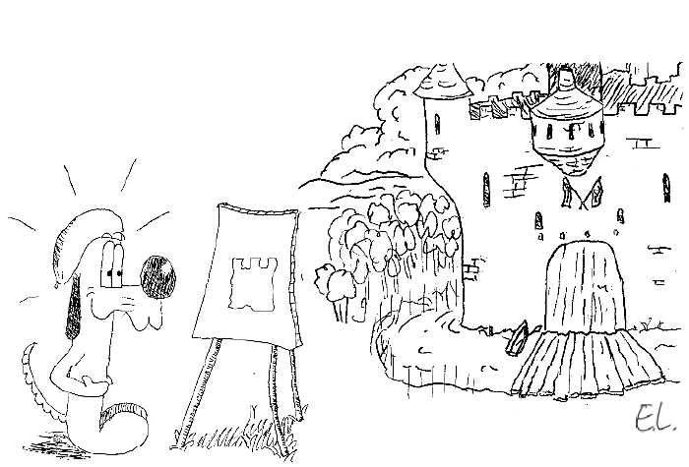
Model Fitting Part 1
Jean-Yves Le Boudec
2021

Slide 2
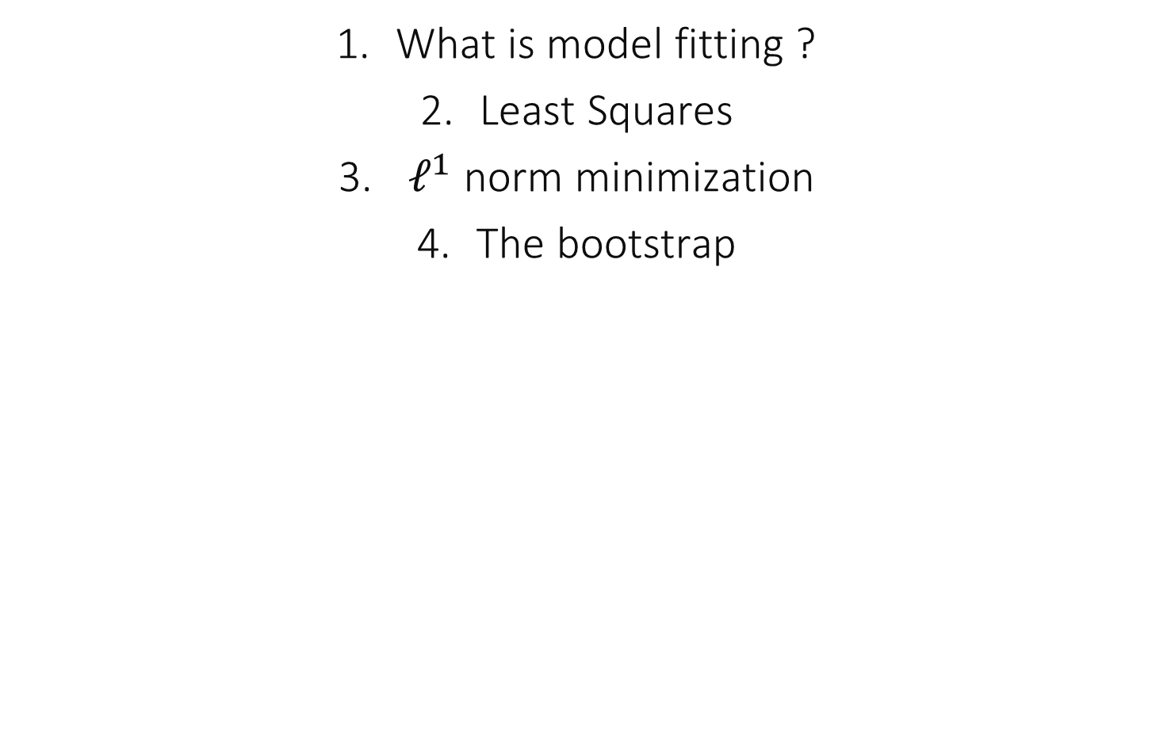
Contents
What is model fitting ?
Least Squares
$ℓ^{1}$ norm minimization
The bootstrap

Slide 3
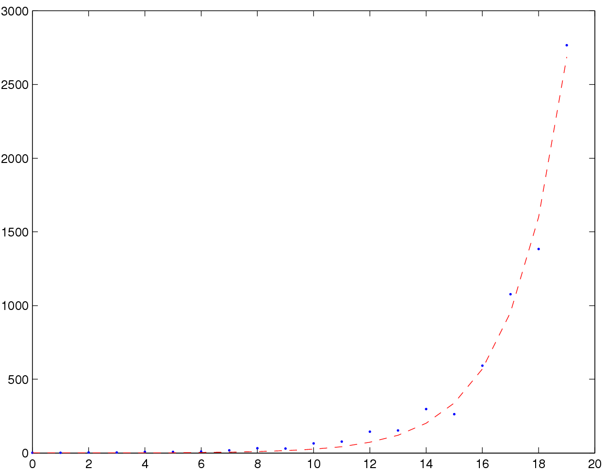
Virus Infection Data
We would like to capture the growth of infected hosts
(explanatory model)
An exponential model seems appropriate
How can we fit the model, in particular, what is the value of α ?

Slide 4
Least Square Fit of Virus Infection Data
α = 0.5173
Mean doubling time 1.34 hours
Prediction at +6 hours: 100 000 hosts
Least square fit

Slide 5
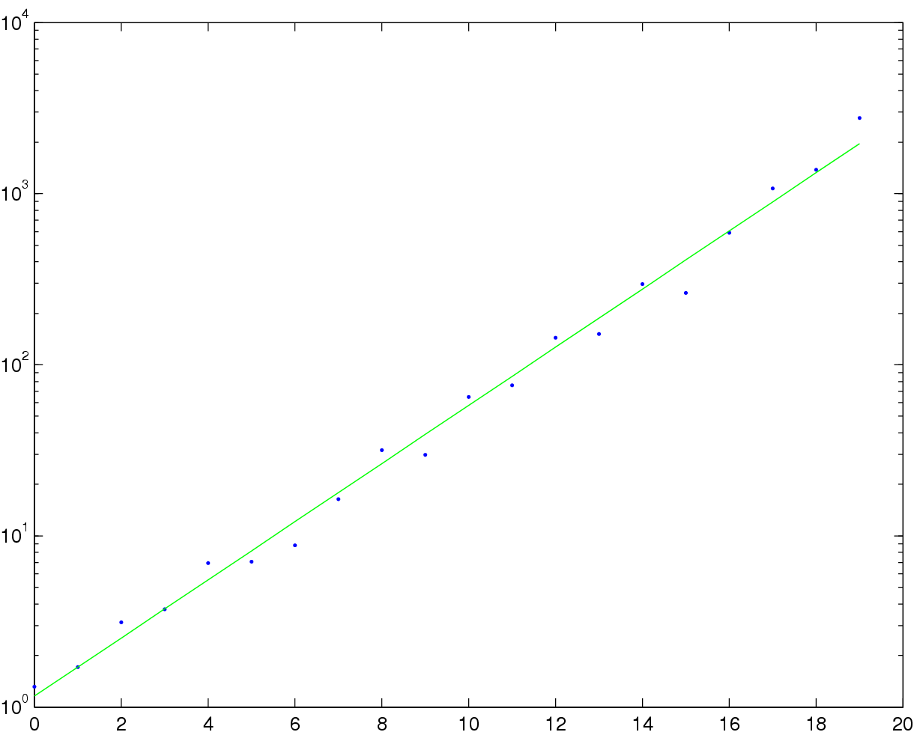
Least Square Fit of Virus Infection Data In Log Scale
α = 0.39
Mean doubling time 1.77 hours
Prediction at +6 hours: 39 000 hosts
Least square fit

Slide 6
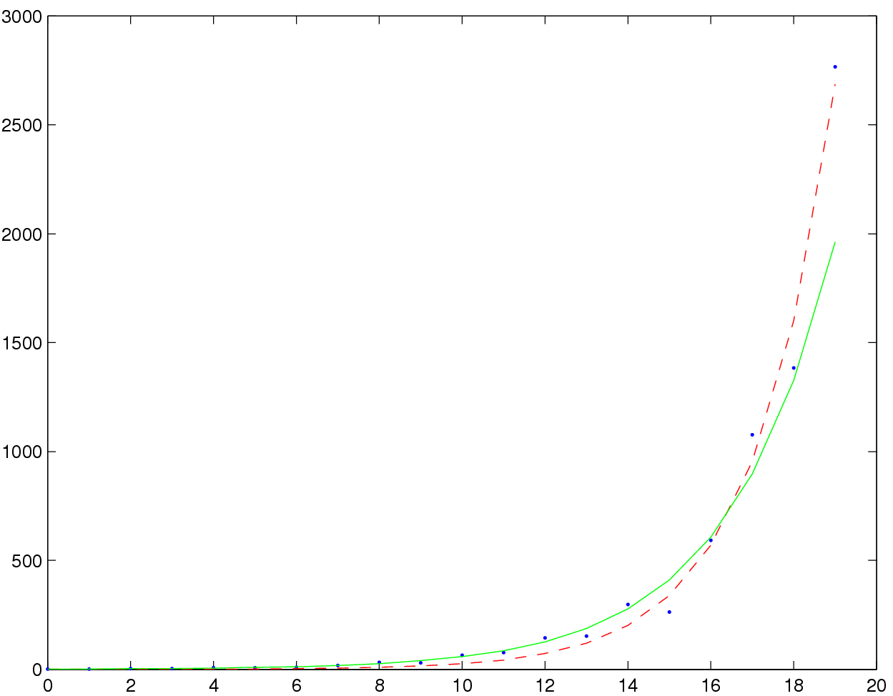
Compare the Two
LS fit in natural scale
LS fit in log scale

Slide 7
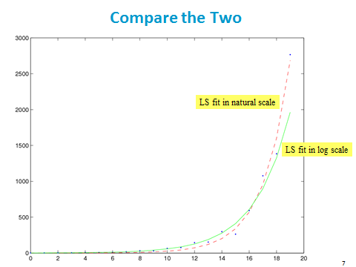
Which scale should I use ?
The natural scale because it is the simplest (principle of parsimony)
The log scale because it is better adapted to exponential growth
I don’t know

Slide 8
Solution
It is not possible to answer this question simply by looking at the scale.
We need to understand what model fitting really is.

Slide 9
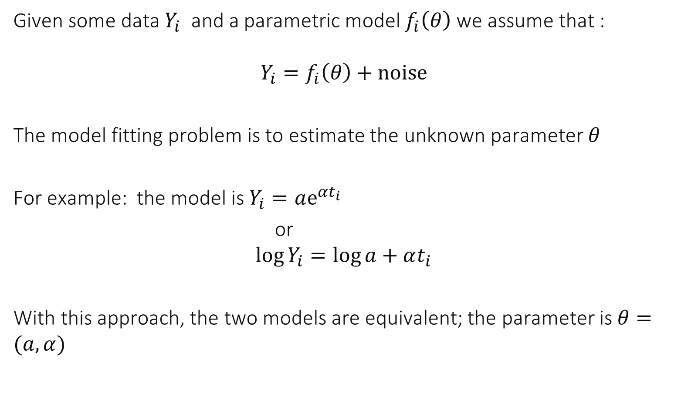
What is model fitting ?
Given some data $Y_{i}$ and a parametric model $f_{i}\left(θ\right)$ we assume that :
$$Y_{i}=f_{i}\left(θ\right)+noise$$
The model fitting problem is to estimate the unknown parameter $θ$
For example: the model is $Y_{i}=ae^{αt_{i}}$
or $$\log{Y_{i}}=\log{a}+αt_{i}$$
With this approach, the two models are equivalent; the parameter is $θ=(a, α)$

Slide 10
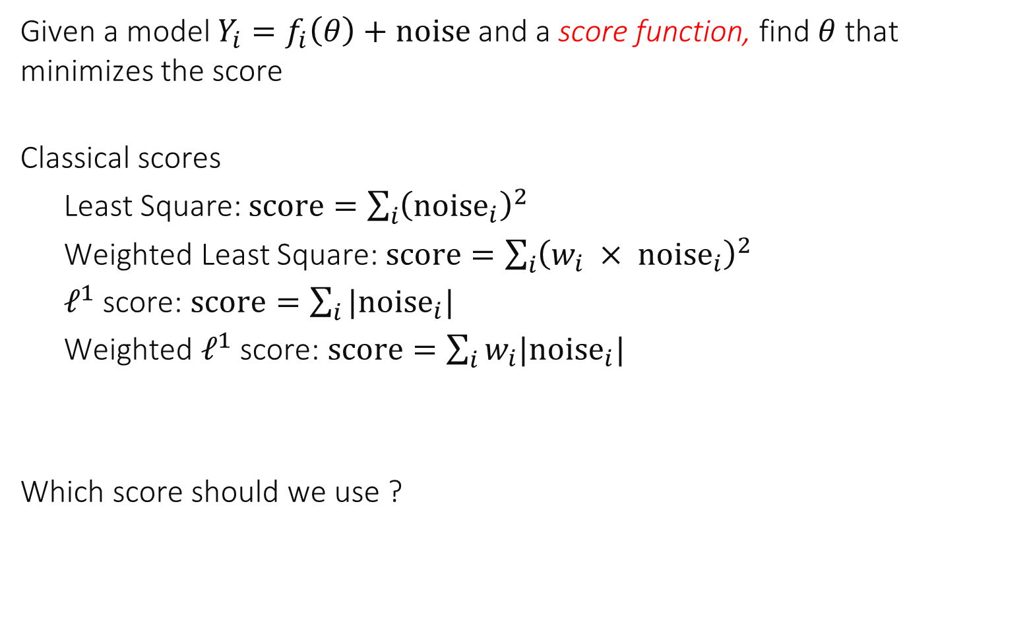
The signal processing interpretation
Given a model $Y_{i}=f_{i}\left(θ\right)+noise$ and a score function, find $θ$ that minimizes the score
Classical scores
Least Square: $score=\sum_{i}{{\left(noise_{i}\right)}^{2}}$
Weighted Least Square: $score=\sum_{i}{{\left(w_{i} × noise_{i}\right)}^{2}}$
$ℓ^{1}$ score: $score=\sum_{i}{|{noise}_{i}|}$
Weighted $ℓ^{1}$ score: $score=\sum_{i}{w_{i}|{noise}_{i}|}$
Which score should we use ?

Slide 11
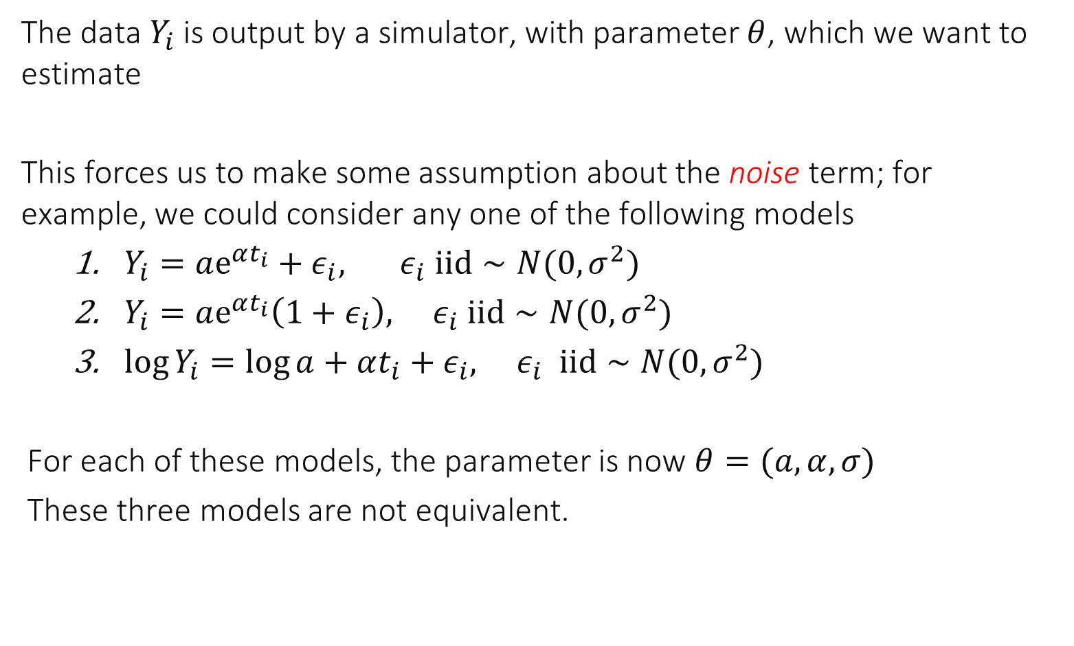
The statistical interpretation
The data $Y_{i}$ is output by a simulator, with parameter $θ$, which we want to estimate
This forces us to make some assumption about the noise term; for example, we could consider any one of the following models
$Y_{i}=ae^{αt_{i}}+ε_{i}, ε_{i} iid∼N(0,σ^{2})$
$Y_{i}=ae^{αt_{i}}\left(1+ε_{i}\right), ε_{i} iid∼N(0,σ^{2})$
$\log{Y_{i}}=\log{a}+αt_{i}+ε_{i}, ε_{i} iid∼N(0,σ^{2})$
For each of these models, the parameter is now $θ=(a, α, σ)$
These three models are not equivalent.

Slide 12
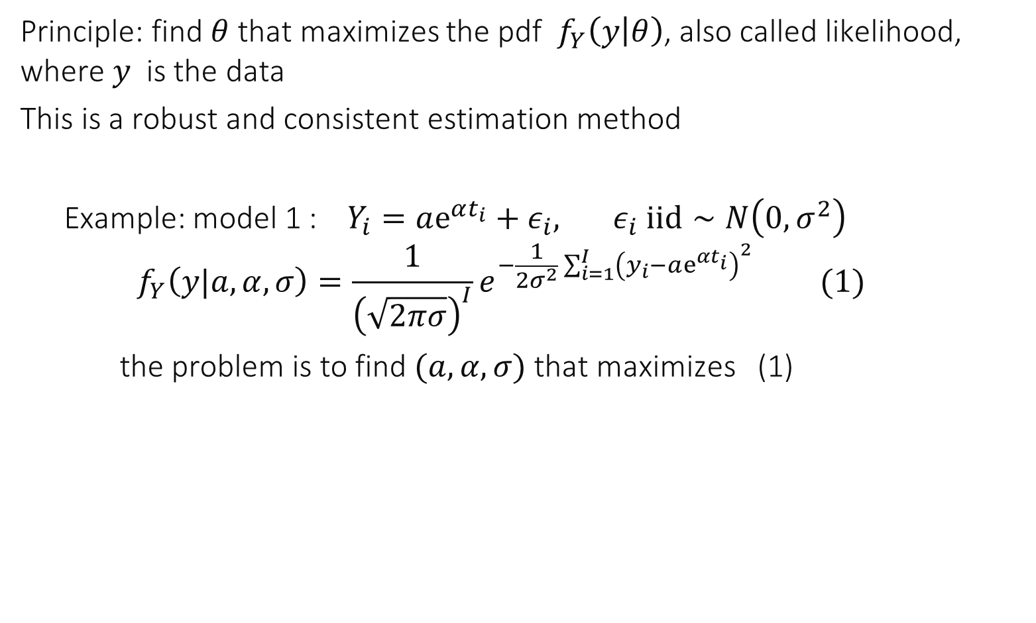
Estimating a statistical model: maximum likelihood
Principle: find $θ$ that maximizes the pdf $f_{Y}\left(y | θ\right)$, also called likelihood, where $y$ is the data
This is a robust and consistent estimation method
Example: model 1 : $Y_{i}=ae^{αt_{i}}+ε_{i}, ε_{i} iid∼N\left(0,σ^{2}\right)$ $$f_{Y}\left(y|a,α, σ\right)=\frac{1}{{\left(\sqrt{2πσ}\right)}^{I}}e^{−\frac{1}{2σ^{2}}\sum_{i=1}^{I}{{\left(y_{i}−ae^{αt_{i}}\right)}^{2}}} (1)$$
the problem is to find $(a,α, σ)$ that maximizes (1)

Slide 13
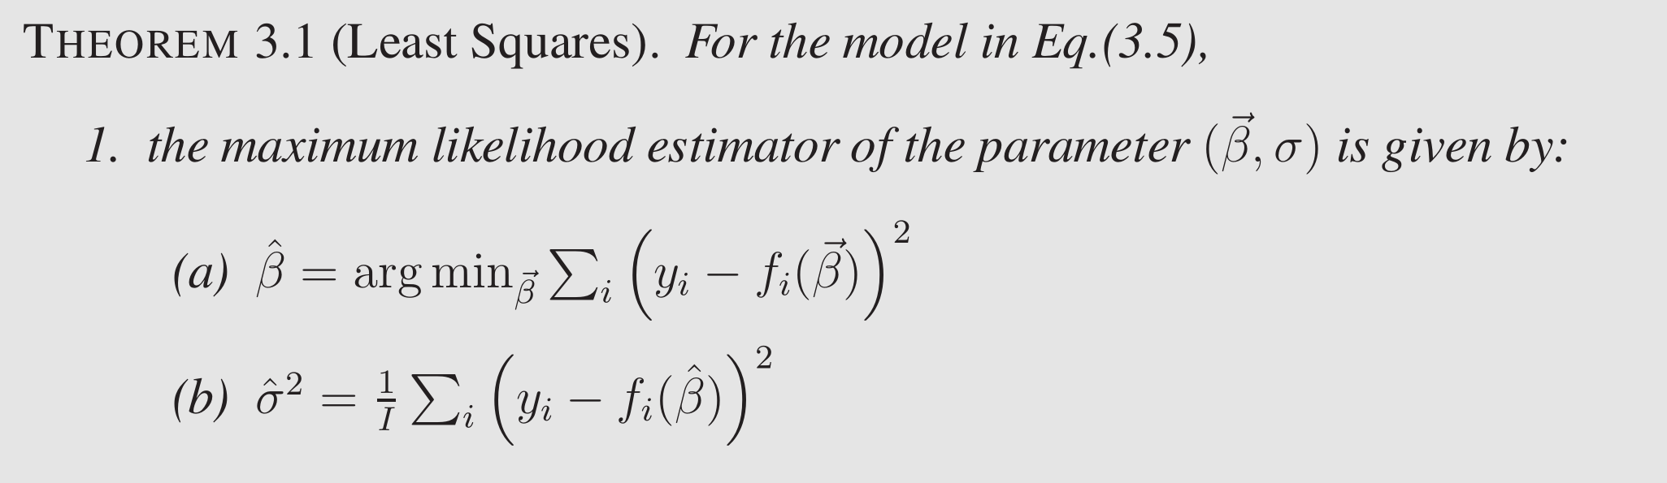
Least Square Score = Gaussian iid Noise
Assume model (homoscedasticity)
i.e. the signal processing method with Least Squares score is the same as the statistical method with iid gaussian noise

Slide 14
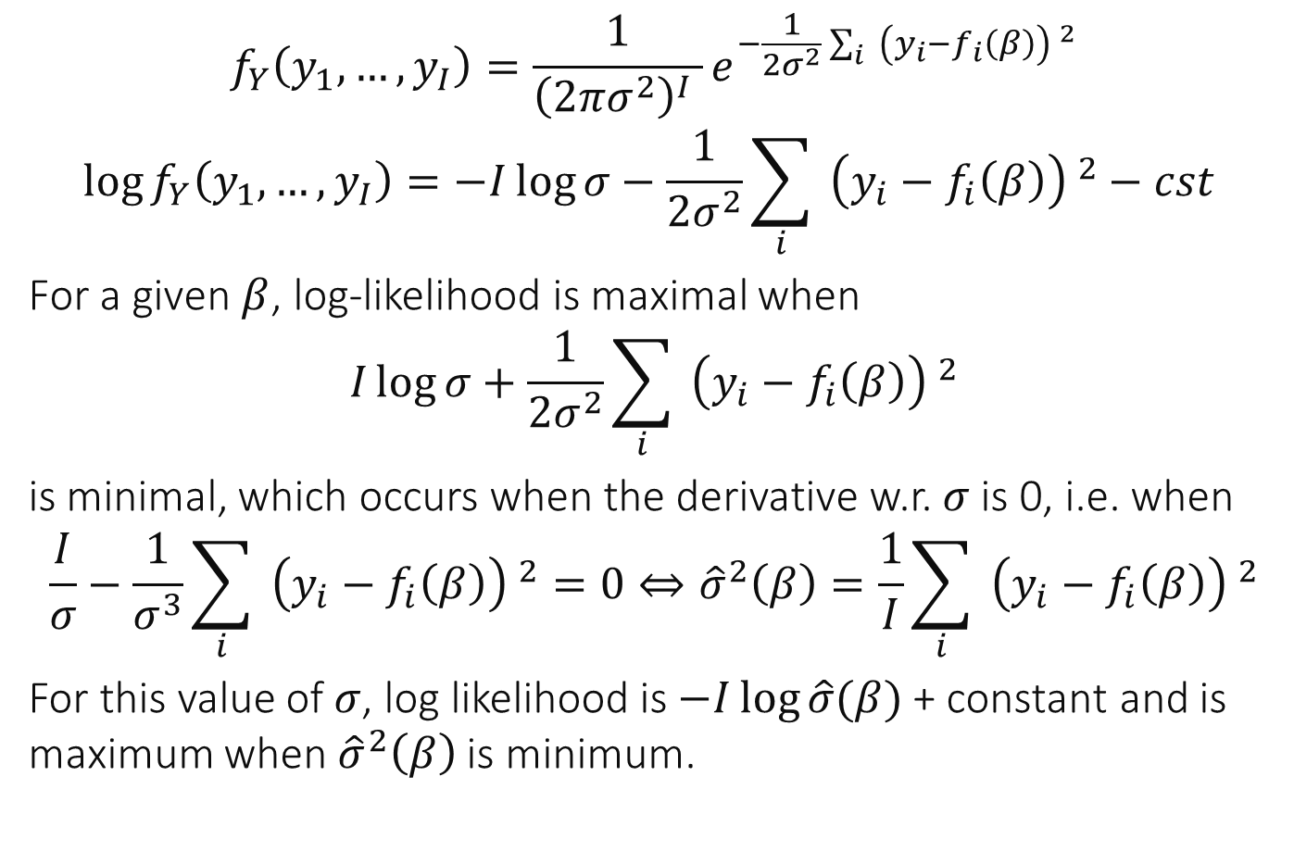
Proof
$$f_{Y}\left(y_{1},…,y_{I}\right)=\frac{1}{{\left(2πσ^{2}\right)}^{I} }e^{−\frac{1}{2σ^{2}}\sum_{i}{{ \left(y_{i}−f_{i}\left(β\right)\right) }^{2}}}$$
$$\log{f_{Y}\left(y_{1},…,y_{I}\right)=−I\log{σ}−\frac{1}{2σ^{2}}}\sum_{i}{{ \left(y_{i}−f_{i}\left(β\right)\right) }^{2}}−cst$$
For a given $β$, log-likelihood is maximal when
$$I\log{σ}+\frac{1}{2σ^{2}}\sum_{i}{{ \left(y_{i}−f_{i}\left(β\right)\right) }^{2}}$$
is minimal, which occurs when the derivative w.r. $σ$ is 0, i.e. when
$$\frac{I}{σ}−\frac{1}{σ^{3}}\sum_{i}{{ \left(y_{i}−f_{i}\left(β\right)\right) }^{2}}=0⇔{\hat{σ}}^{2}\left(β\right)=\frac{1}{I}\sum_{i}{{ \left(y_{i}−f_{i}\left(β\right)\right) }^{2}}$$
For this value of $σ$, log likelihood is $−I\log{\hat{σ}(β)}$ + constant and is maximum when ${\hat{σ}}^{2}\left(β\right)$ is minimum.
Likelihood
Log-likelihood

Slide 15
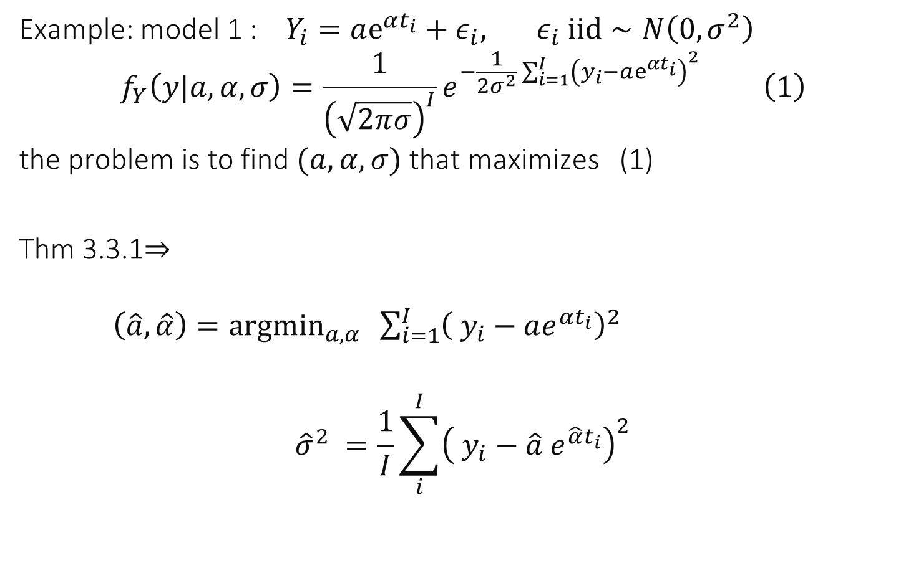
Example: model 1 : $Y_{i}=ae^{αt_{i}}+ε_{i}, ε_{i} iid∼N\left(0,σ^{2}\right)$ $$f_{Y}\left(y|a,α, σ\right)=\frac{1}{{\left(\sqrt{2πσ}\right)}^{I}}e^{−\frac{1}{2σ^{2}}\sum_{i=1}^{I}{{\left(y_{i}−ae^{αt_{i}}\right)}^{2}}} \left(1\right)$$ the problem is to find $(a,α, σ)$ that maximizes (1)
Thm 3.3.1$⇒$ $\left(\hat{a},\hat{α}\right)=argmin_{a,α} \sum_{i=1}^{I}{{\left( y_{i}−ae^{αt_{i}}\right)}^{2}}$
$${\hat{σ}}^{2} =\frac{1}{I}\sum_{i}^{I}{{\left( y_{i}−\hat{a} e^{\hat{α}t_{i}}\right)}^{2}}$$

Slide 16
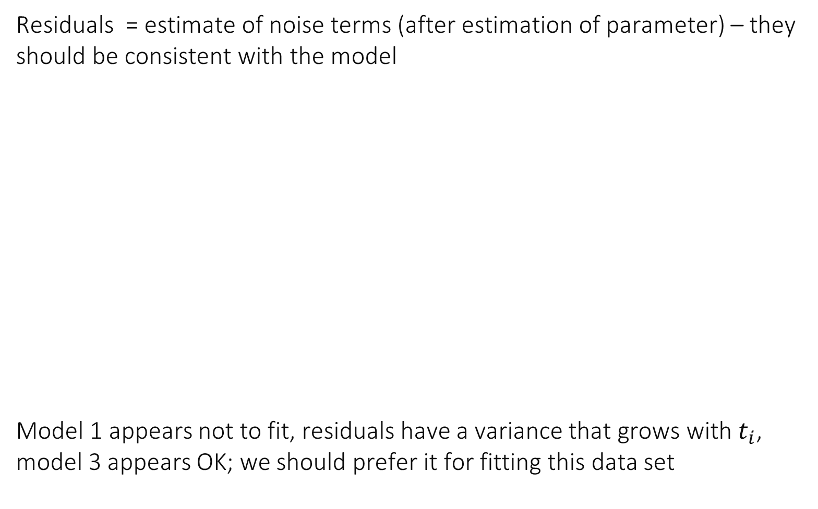

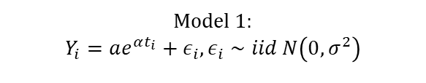
The residuals can help validate a fitting method
Residuals = estimate of noise terms (after estimation of parameter) – they should be consistent with the model
Model 1 appears not to fit, residuals have a variance that grows with $t_{i}$, model 3 appears OK; we should prefer it for fitting this data set
Model 1:
$$Y_{i}=ae^{αt_{i}}+ε_{i}, ε_{i}∼iid N\left(0,σ^{2}\right)$$
Model 3:
$$\log{Y_{i}}=\log{a}+αt_{i}+ε_{i}, ε_{i}∼iid N\left(0,σ^{2}\right)$$

Slide 17
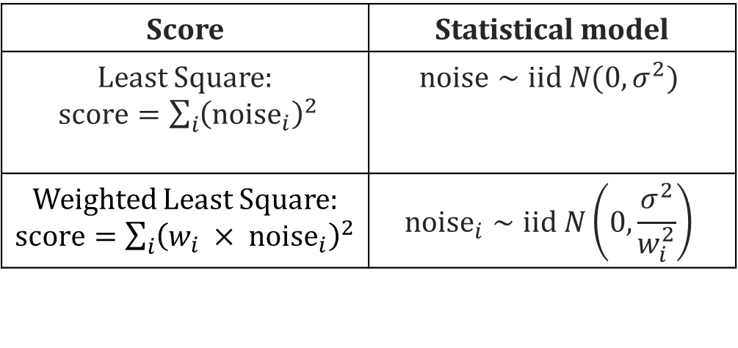
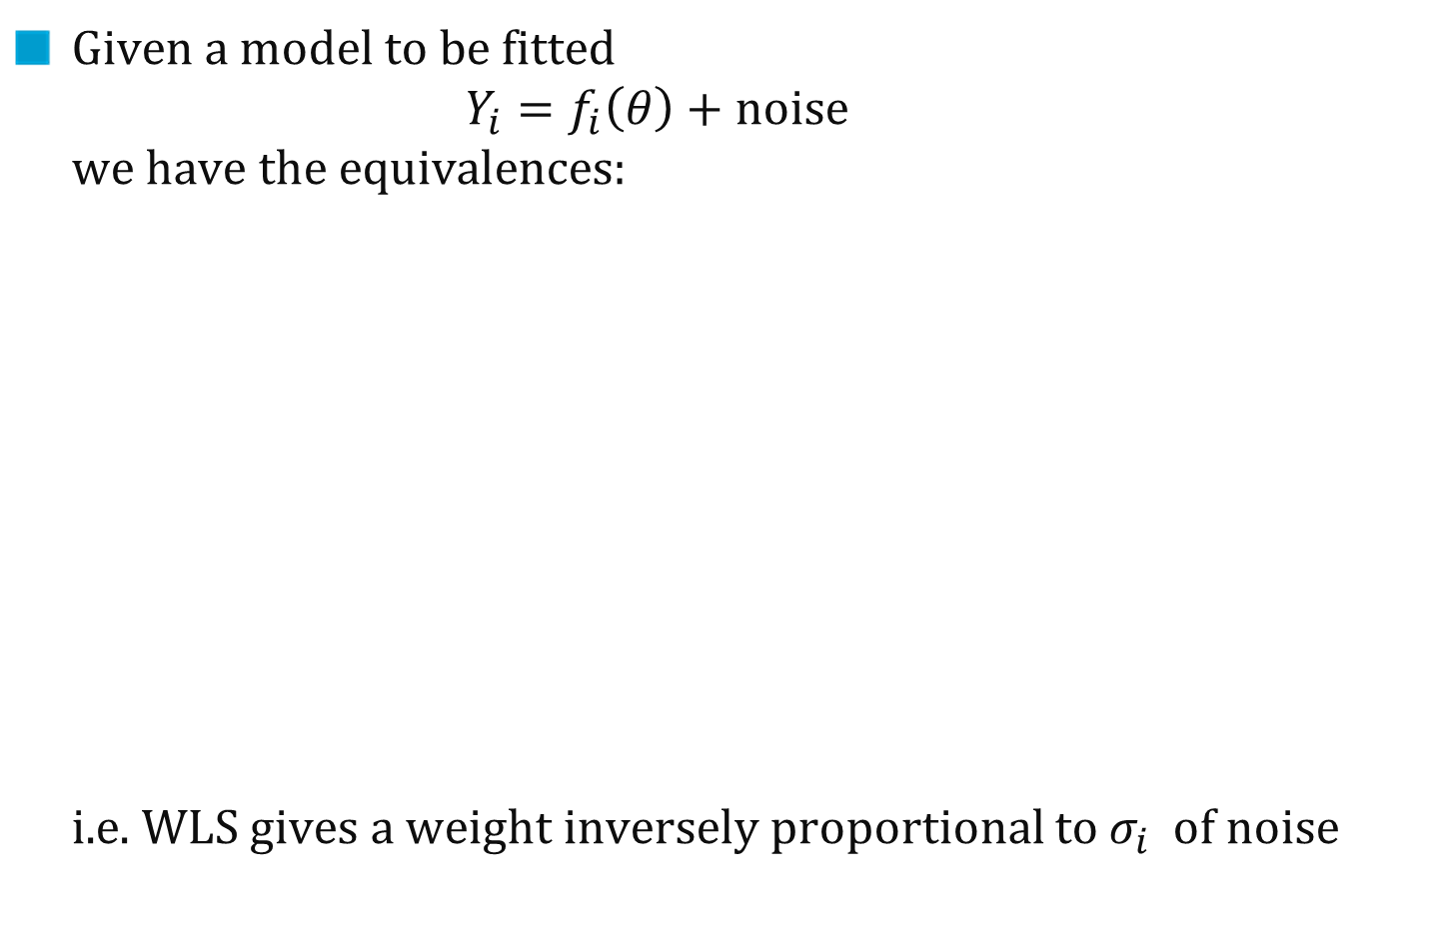
LS score functions
Given a model to be fitted $Y_{i}=f_{i}\left(θ\right)+noise$ we have the equivalences: i.e. WLS gives a weight inversely proportional to $σ_{i}$ of noise
Score | Statistical model
Least Square: $score=\sum_{i}{{\left(noise_{i}\right)}^{2}}$ | $$noise∼iid N(0, σ^{2})$$
Weighted Least Square: $score=\sum_{i}{{\left(w_{i} × noise_{i}\right)}^{2}}$ | $${noise}_{i}∼iid N\left(0,\frac{σ^{2}}{w_{i}^{2}}\right)$$

Slide 18
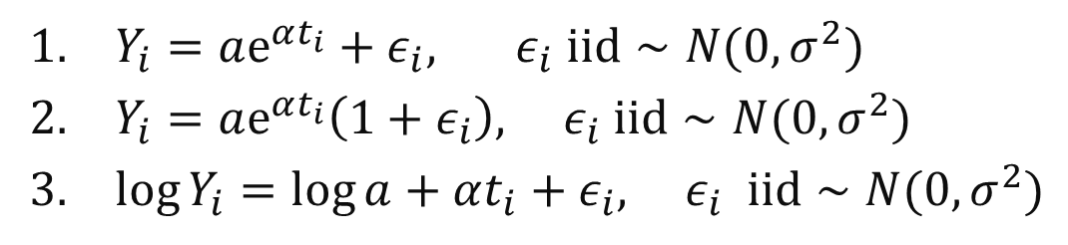
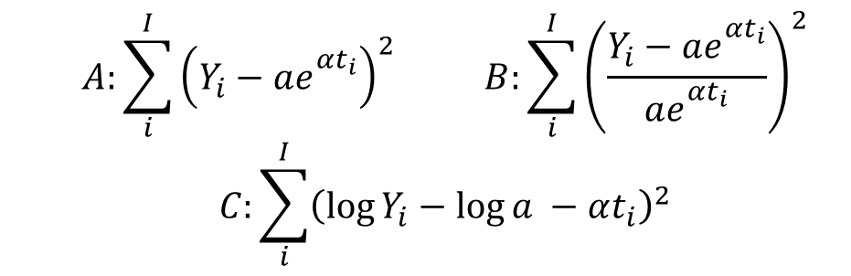
Which score corresponds to which model ?
A1 B2 C3
A1 B3 C2
A2 B1 C3
A2 B3 C1
A3 B1 C2
A3 B2 C1
I don’t know
$$A:\sum_{i}^{I}{{\left(Y_{i}−ae_{}^{αt_{i}}\right)}^{2}} B:\sum_{i}^{I}{{\left(\frac{Y_{i}−ae_{}^{αt_{i}}}{ae_{}^{αt_{i}}}\right)}^{2}}$$
$$C:\sum_{i}^{I}{{\left(\log{Y_{i}}−\log{a} −αt_{i}\right)}^{2}}$$

Slide 19
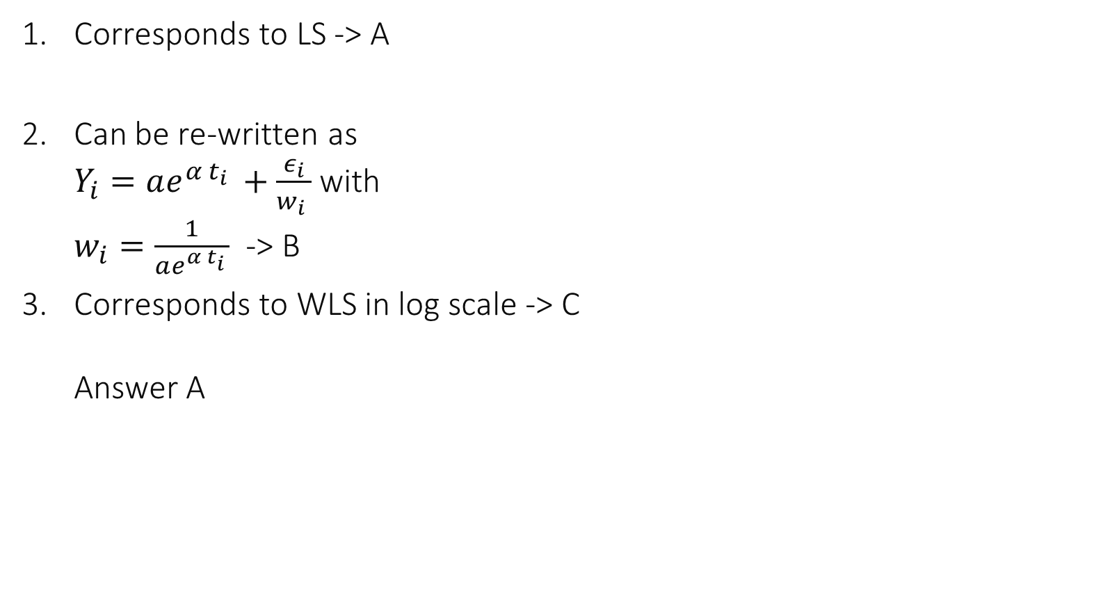
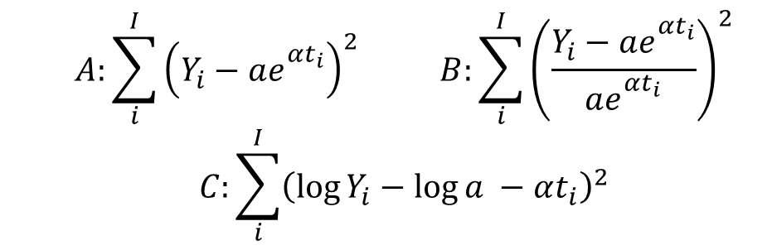
Corresponds to LS -> A
Can be re-written as $Y_{i}=ae^{α t_{i} }+\frac{ε_{i}}{w_{i} }$ with $w_{i}=\frac{1}{ae^{α t_{i} }}$ -> B
Corresponds to WLS in log scale -> C Answer A
$$A:\sum_{i}^{I}{{\left(Y_{i}−ae_{}^{αt_{i}}\right)}^{2}} B:\sum_{i}^{I}{{\left(\frac{Y_{i}−ae_{}^{αt_{i}}}{ae_{}^{αt_{i}}}\right)}^{2}}$$
$$C:\sum_{i}^{I}{{\left(\log{Y_{i}}−\log{a} −αt_{i}\right)}^{2}}$$

Slide 20
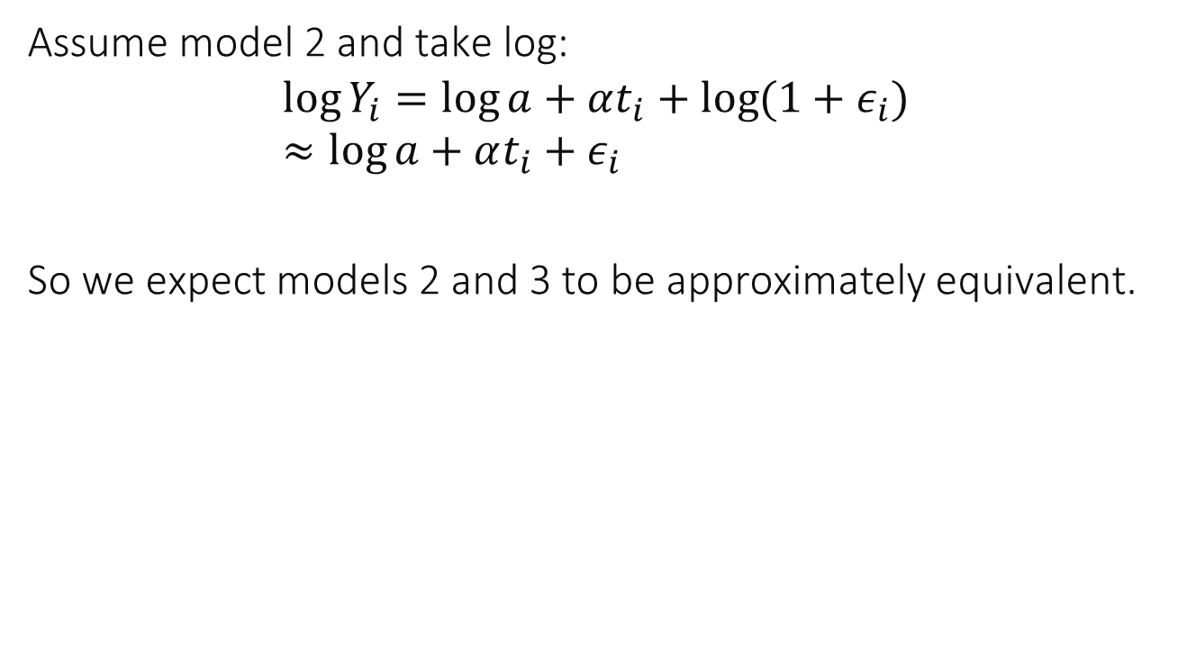
Compare models 2 and 3
Assume model 2 and take log: $$\log{Y_{i}}=\log{a}+αt_{i}+\log{(1+ε_{i})} \\ ≈\log{a}+αt_{i}+ε_{i}$$
So we expect models 2 and 3 to be approximately equivalent.

Slide 21
Take-Home Message
In order to fit a model you need to find an appropriate score function.
One easy way to determine one is to consider an explicit model of the noise, and verify it by looking at residuals
A common mistake is to assume that noise has same variance when it is obviously wrong (e.g. model 1)
Furthermore, we may be interested in finding confidence intervals for the estimated parameters.

Slide 22
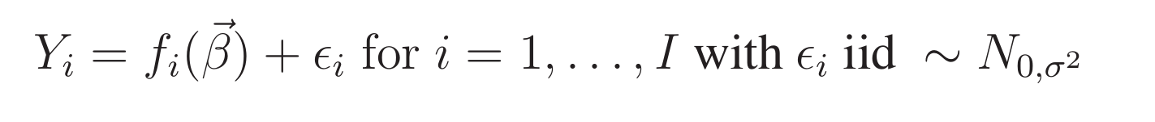
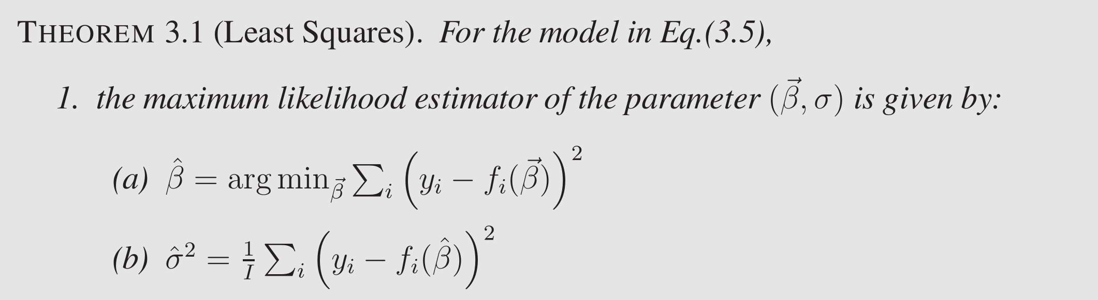
2. Least Squares
Very commonly used
Efficient solution, lots of softwares
And gives confidence intervals

Slide 23
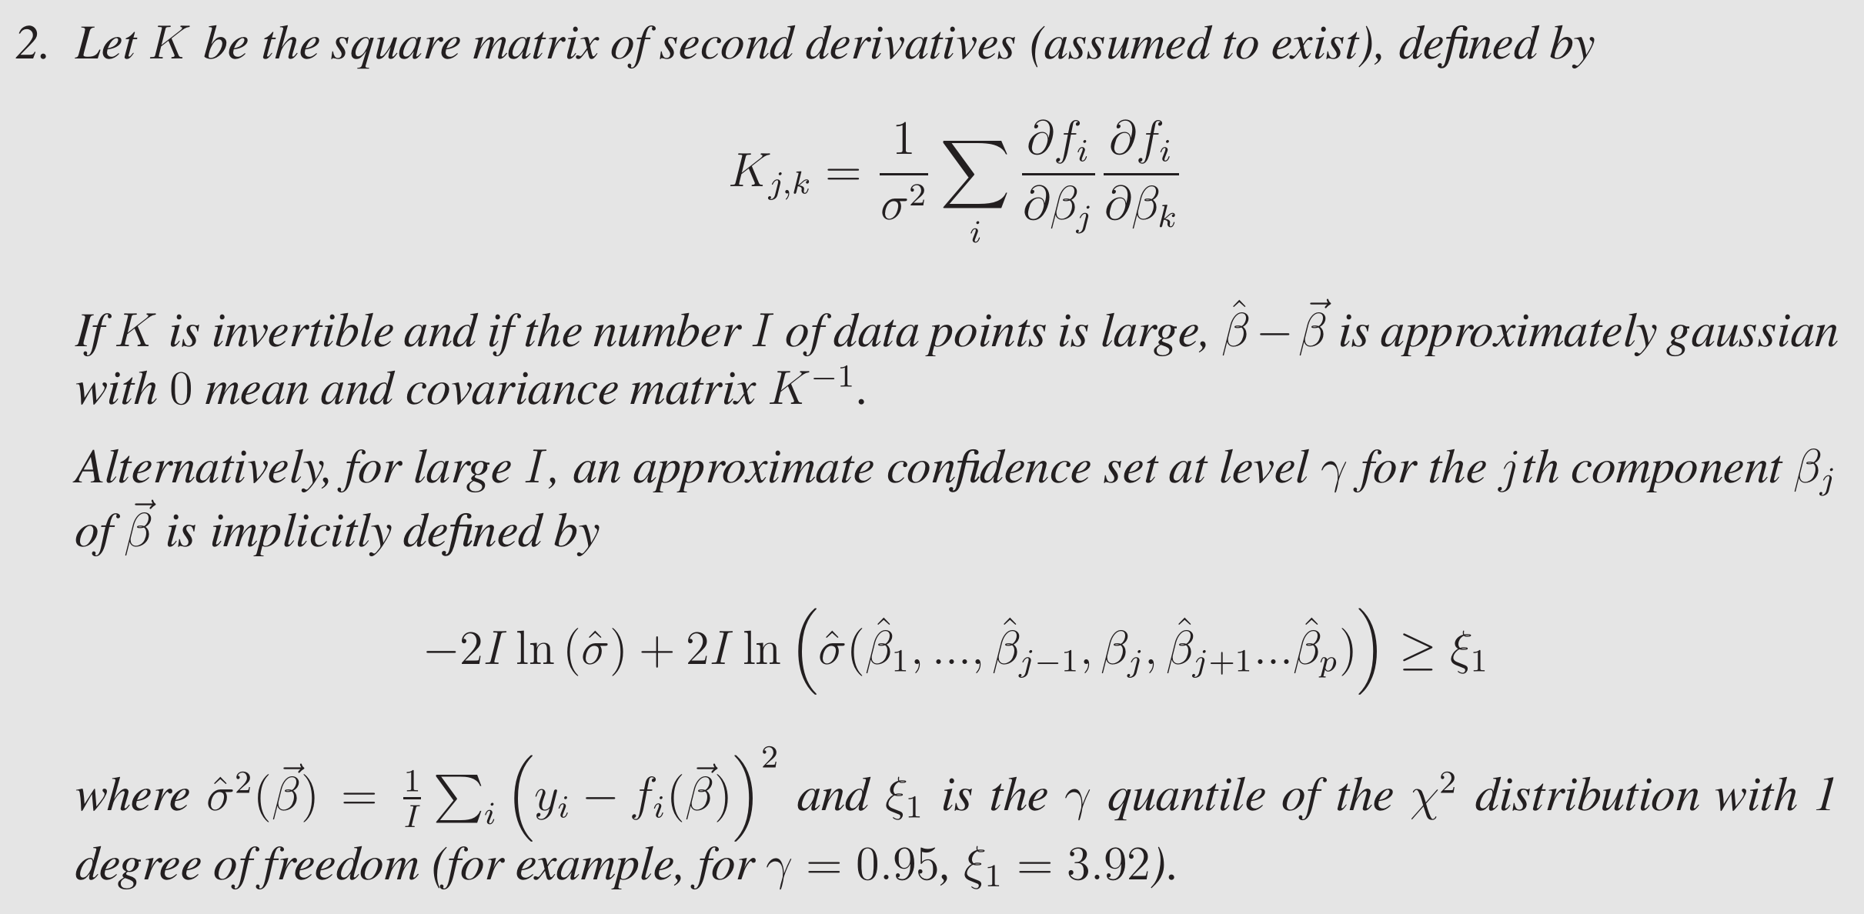
Confidence Intervals

Slide 24
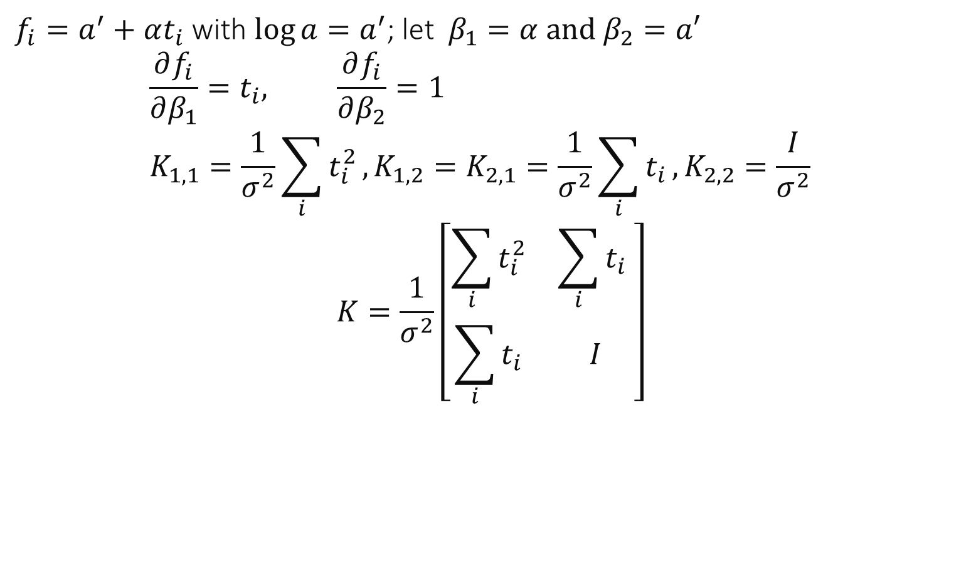
Example: model 3
$f_{i}=a^{′}+αt_{i}$ with $\log{a}=a^{′}$; let$β_{1}=α and β_{2}=a′$
$$\frac{∂f_{i}}{∂β_{1}}=t_{i}, \frac{∂f_{i}}{∂β_{2}}=1 \\ K_{1,1}=\frac{1}{σ^{2}}\sum_{i}{t_{i}^{2}}, K_{1,2}=K_{2,1}=\frac{1}{σ^{2}}\sum_{i}{t_{i}},K_{2,2}=\frac{I}{σ^{2}}$$
$$K=\frac{1}{σ^{2}}\left[\begin{matrix}\sum_{i}{t_{i}^{2}} & \sum_{i}{t_{i}} \\ \sum_{i}{t_{i}} & I\end{matrix}\right]$$

Slide 25
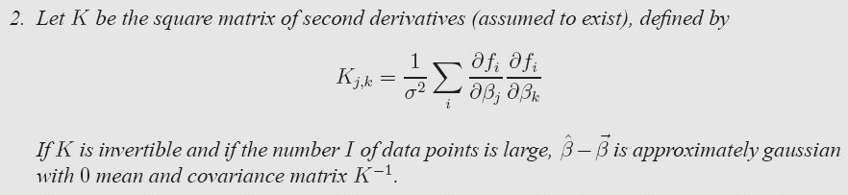
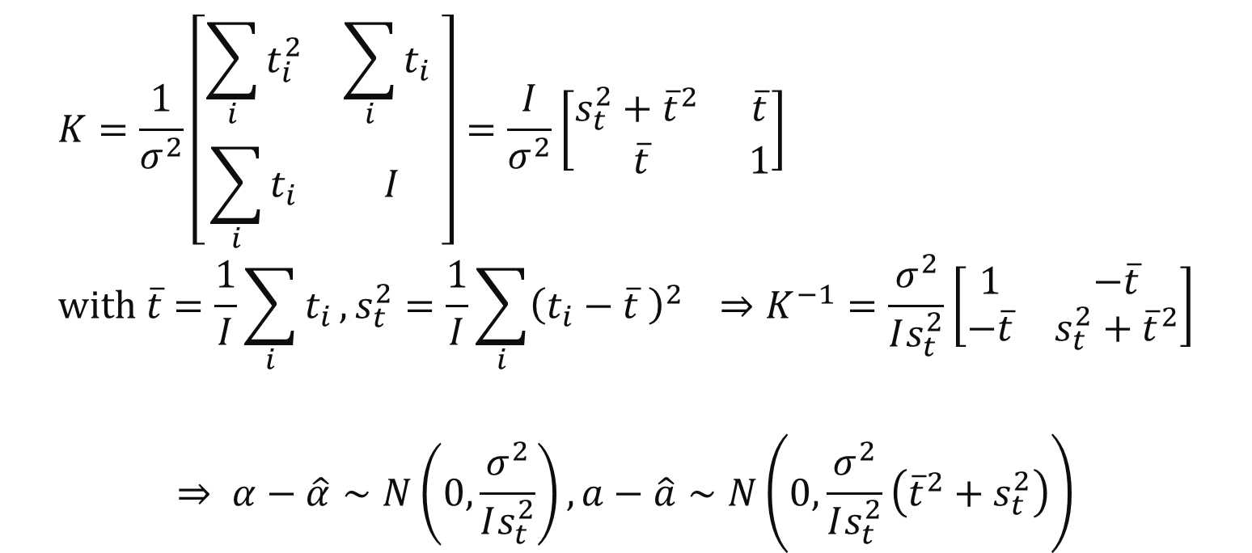
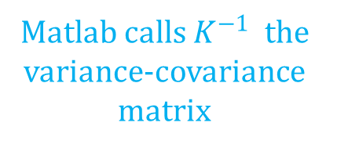
Example: model 3
$$K=\frac{1}{σ^{2}}\left[\begin{matrix}\sum_{i}{t_{i}^{2}} & \sum_{i}{t_{i}} \\ \sum_{i}{t_{i}} & I\end{matrix}\right]=\frac{I}{σ^{2}}\left[\begin{matrix}s_{t}^{2}+{\overline{t}}^{2} & \overline{t} \\ \overline{t} & 1\end{matrix}\right] \\ with \overline{t}=\frac{1}{I}\sum_{i}{t_{i}}, s_{t}^{2}=\frac{1}{I}\sum_{i}{{\left(t_{i}−\overline{t} \right)}^{2}} ⇒K^{−1}=\frac{σ^{2}}{Is_{t}^{2}}\left[\begin{matrix}1 & −\overline{t} \\ −\overline{t} & s_{t}^{2}+{\overline{t}}^{2}\end{matrix}\right]$$
$$⇒ α−\hat{α}∼N\left(0,\frac{σ^{2}}{Is_{t}^{2}}\right),a−\hat{a}∼N\left(0,\frac{σ^{2}}{Is_{t}^{2}}\left({\overline{t}}^{2}+s_{t}^{2}\right)\right)$$
Matlab calls $K^{−1}$ the variance-covariance matrix

Slide 26
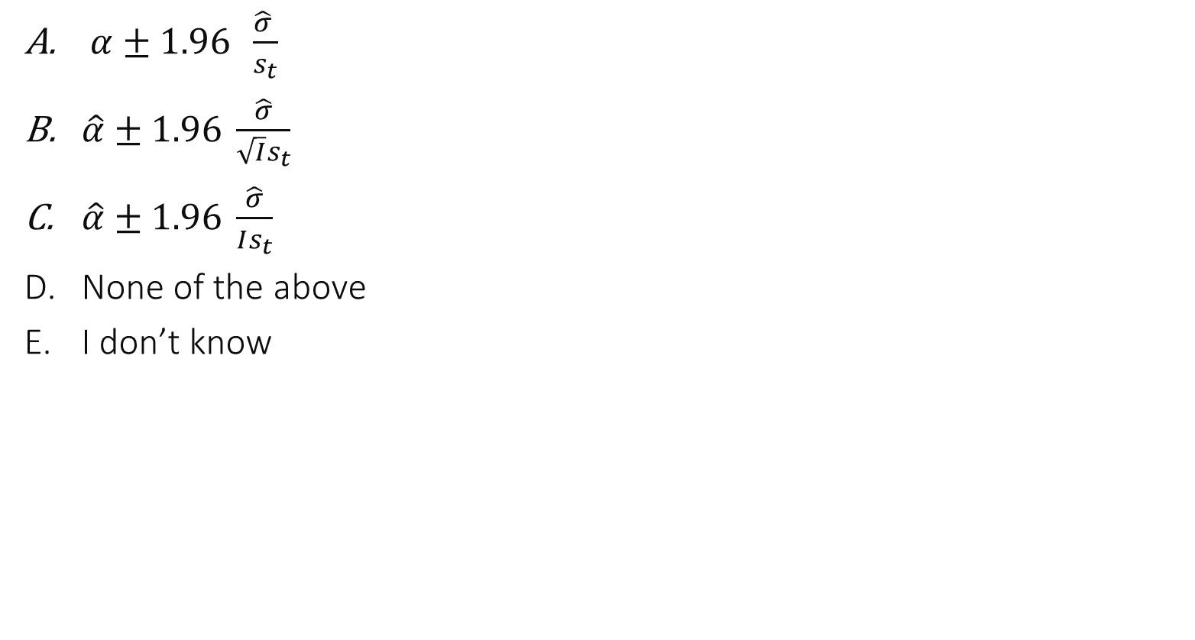
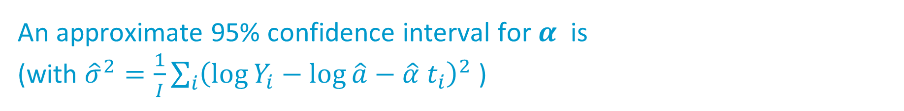
An approximate 95% confidence interval for $α$ is (with ${\hat{σ}}^{2}=\frac{1}{I}\sum_{i}{{\left(\log{Y_{i}}−\log{\hat{a}}−\hat{α} t_{i}\right)}^{2}}$ )
$α±1.96 \frac{\hat{σ} }{s_{t}}$
$\hat{α}±1.96 \frac{\hat{σ}}{\sqrt{I}s_{t}}$
$\hat{α}±1.96 \frac{\hat{σ}}{Is_{t}}$
None of the above
I don’t know

Slide 27
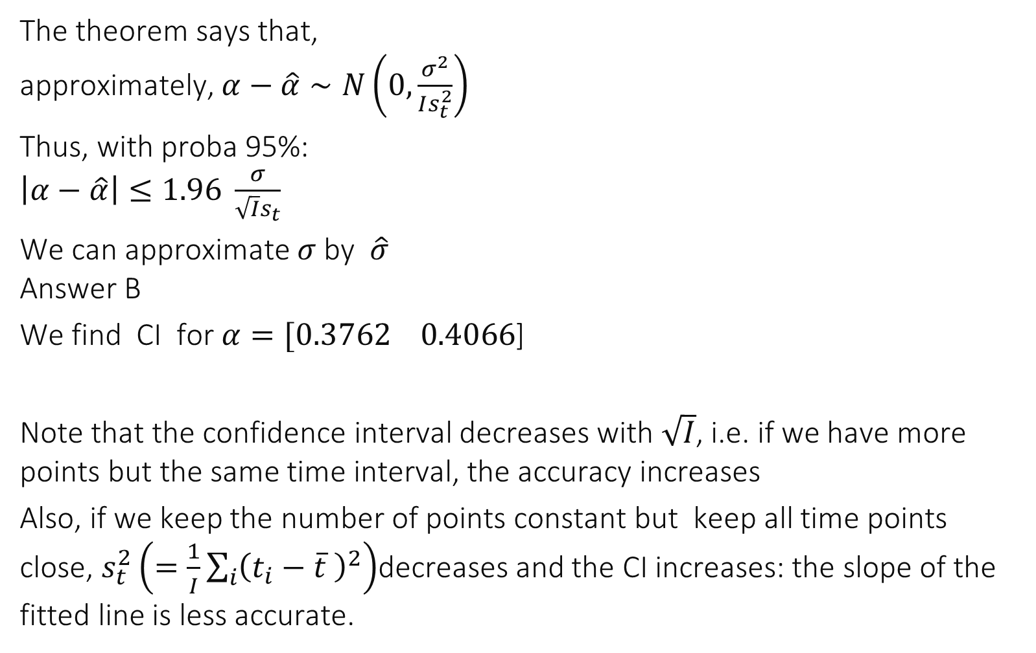
The theorem says that, approximately, $α−\hat{α}∼N\left(0,\frac{σ^{2}}{Is_{t}^{2}}\right)$
Thus, with proba 95%: $\left|α−\hat{α}\right|≤1.96 \frac{σ}{\sqrt{I}s_{t}}$
We can approximate $σ$ by $\hat{σ}$ Answer B
We find CI for $α=[0.3762 0.4066$]
Note that the confidence interval decreases with $\sqrt{I}$, i.e. if we have more points but the same time interval, the accuracy increases
Also, if we keep the number of points constant but keep all time points close, $s_{t}^{2}\left(=\frac{1}{I}\sum_{i}{{\left(t_{i}−\overline{t} \right)}^{2}}\right)$decreases and the CI increases: the slope of the fitted line is less accurate.

Slide 28
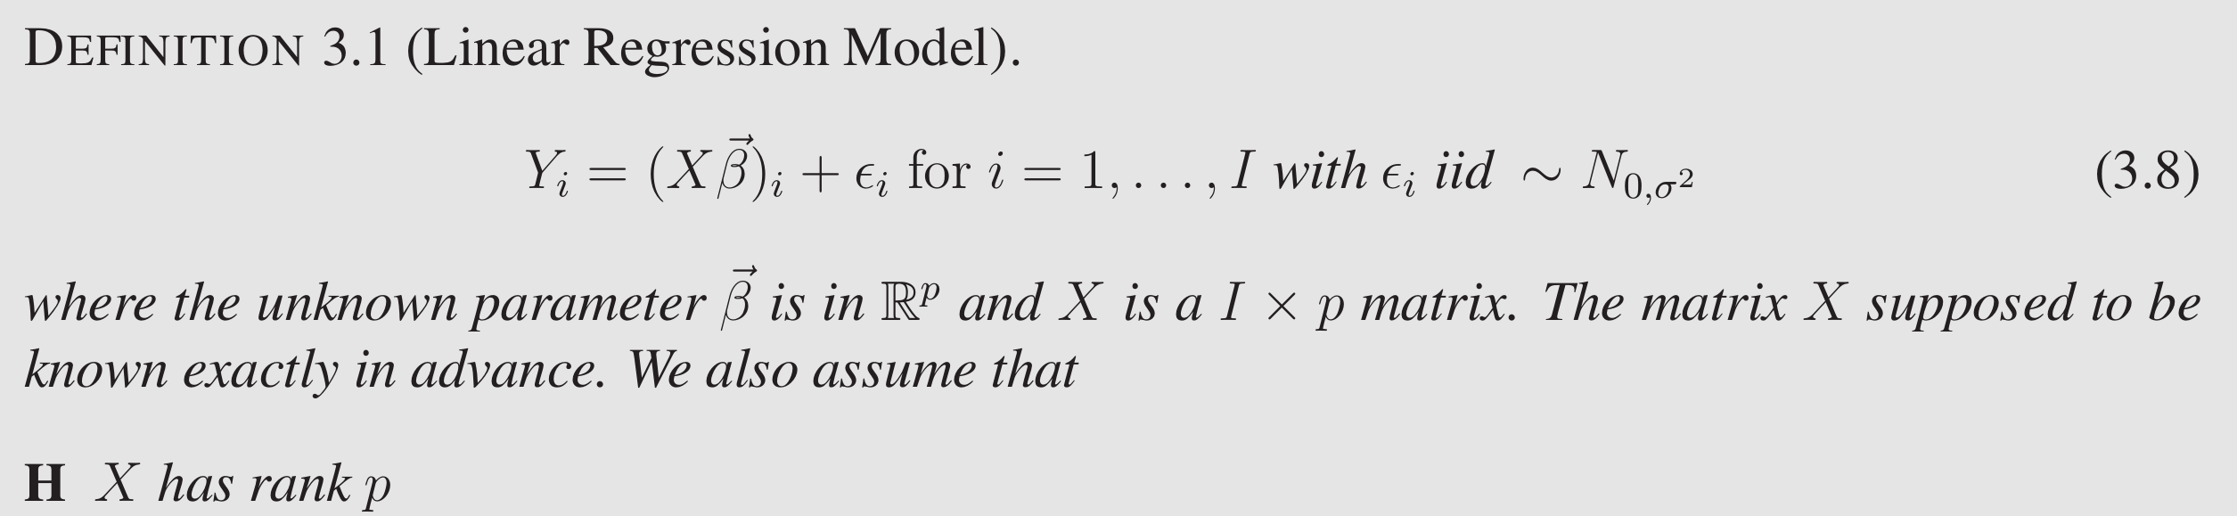
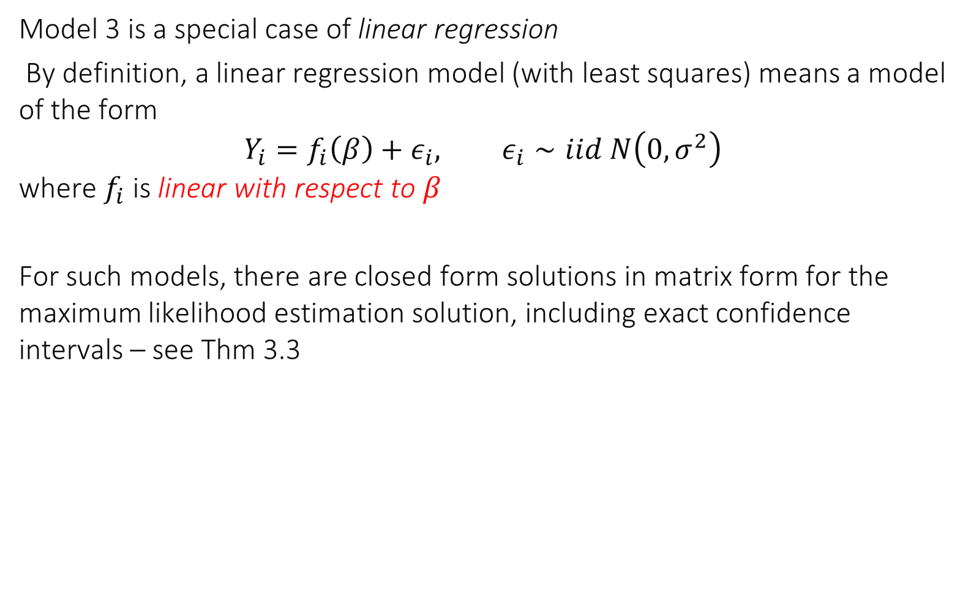
Linear Regression
Model 3 is a special case of linear regression
By definition, a linear regression model (with least squares) means a model of the form $$Y_{i}=f_{i}\left(β\right)+ε_{i}, ε_{i}∼iid N\left(0,σ^{2}\right)$$ where $f_{i}$ is linear with respect to $β$
For such models, there are closed form solutions in matrix form for the maximum likelihood estimation solution, including exact confidence intervals – see Thm 3.3

Slide 29
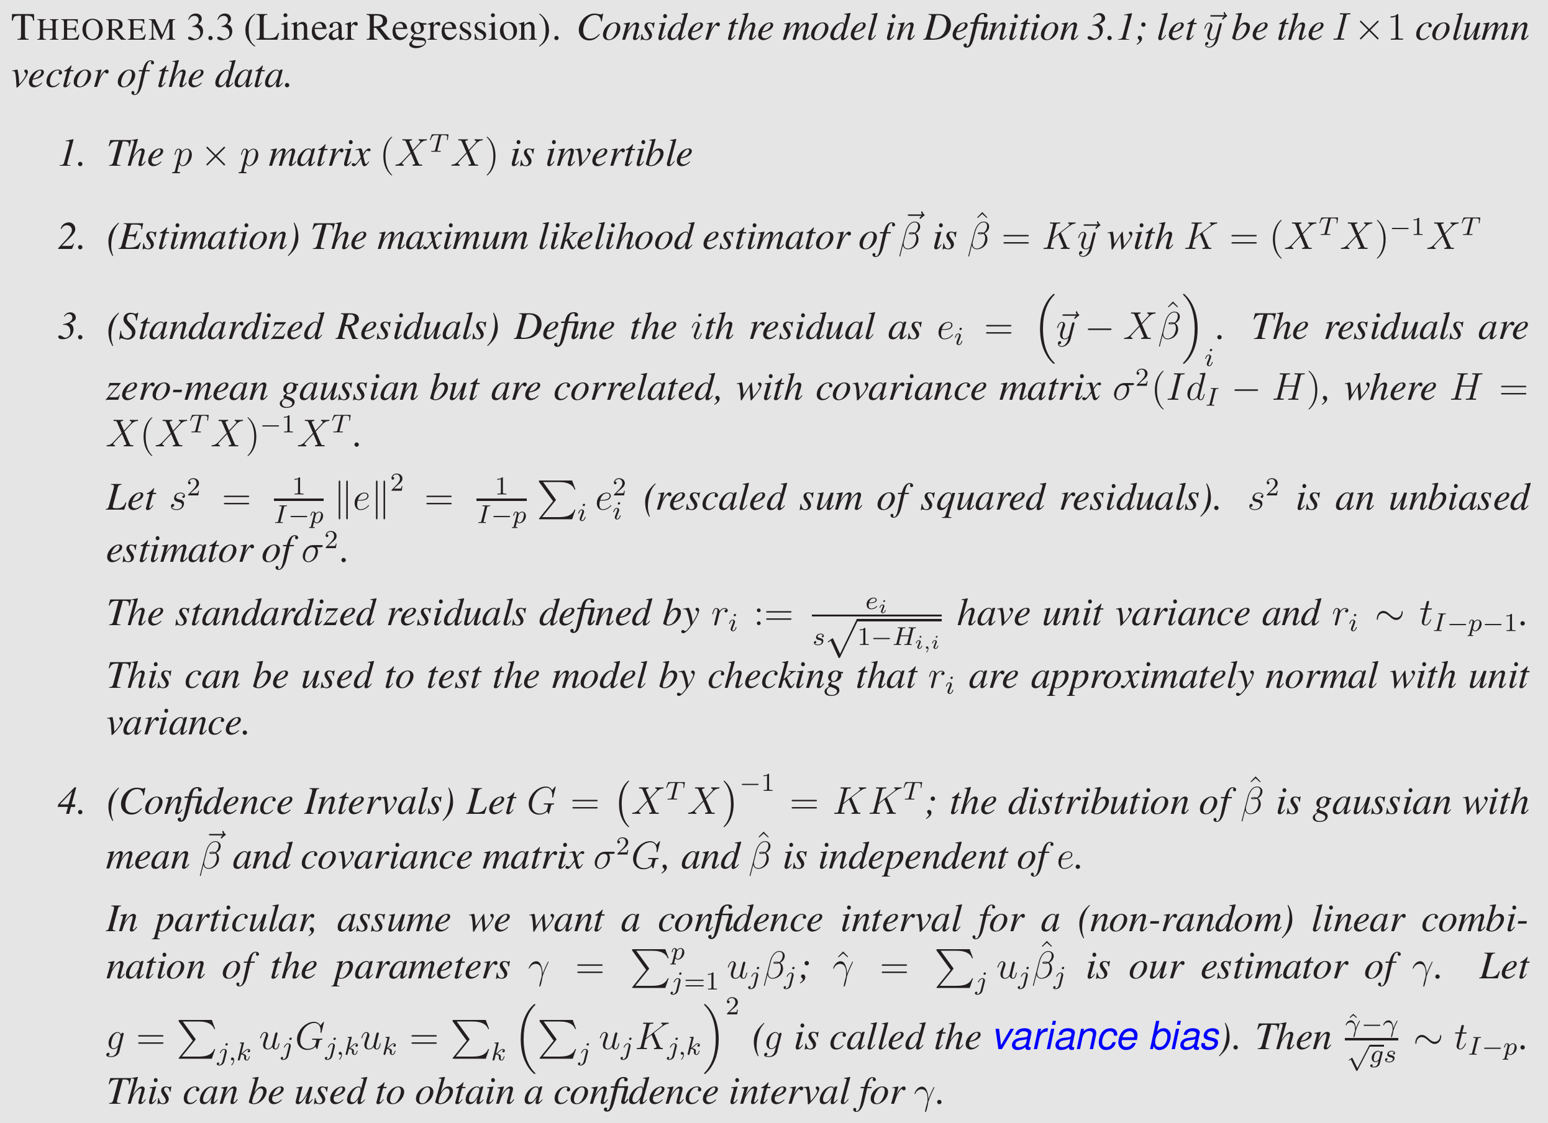

Slide 30
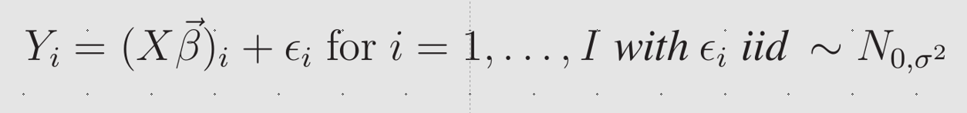
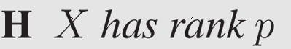

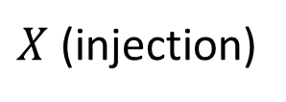
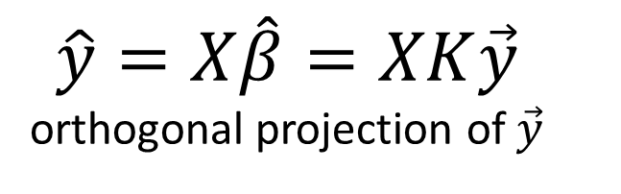
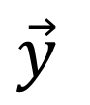
Interpretation of Thm 3.3
Data space
$$\vec{y}$$
Data
$$\hat{y}=X\hat{β}=XK\vec{y}$$ orthogonal projection of $\vec{y}$
Sub-space where the data point would lie
if there would be no noise
Parameter space
$X$ (injection)
Estimated parameter

Slide 31
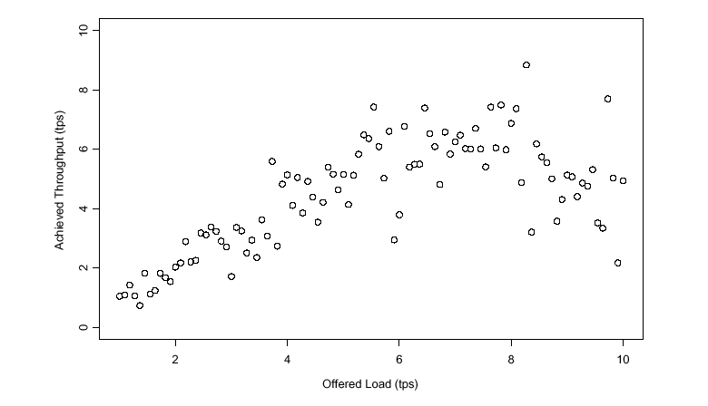
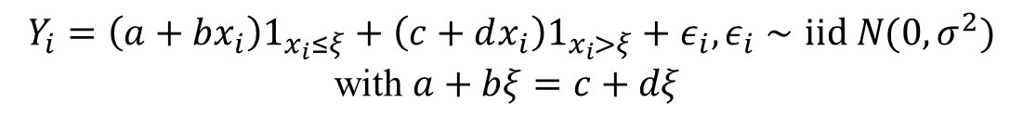
Example: Joe’s shop
$$Y_{i}=\left(a+bx_{i}\right)1_{x_{i}≤ξ}+\left(c+dx_{i}\right)1_{x_{i}>ξ}+ε_{i}, ε_{i}∼iid N(0,σ^{2})$$
with $a+bξ=c+dξ$

Slide 32
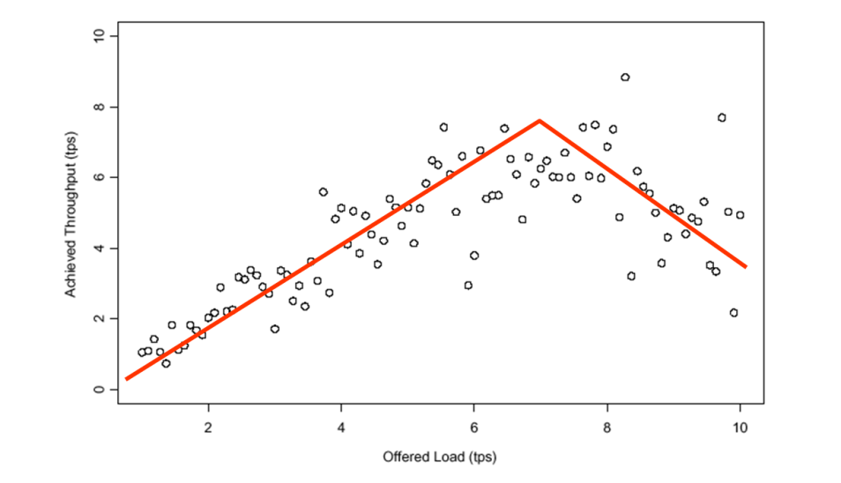
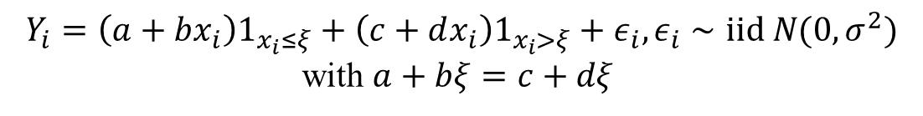

Is this a linear regression model ?
$$Y_{i}=\left(a+bx_{i}\right)1_{x_{i}≤ξ}+\left(c+dx_{i}\right)1_{x_{i}>ξ}+ε_{i}, ε_{i}∼iid N(0,σ^{2})$$
with $a+bξ=c+dξ$
Yes
Yes if we assume $ξ$ is known
No, even if $ξ$ is not known
I don’t know

Slide 33
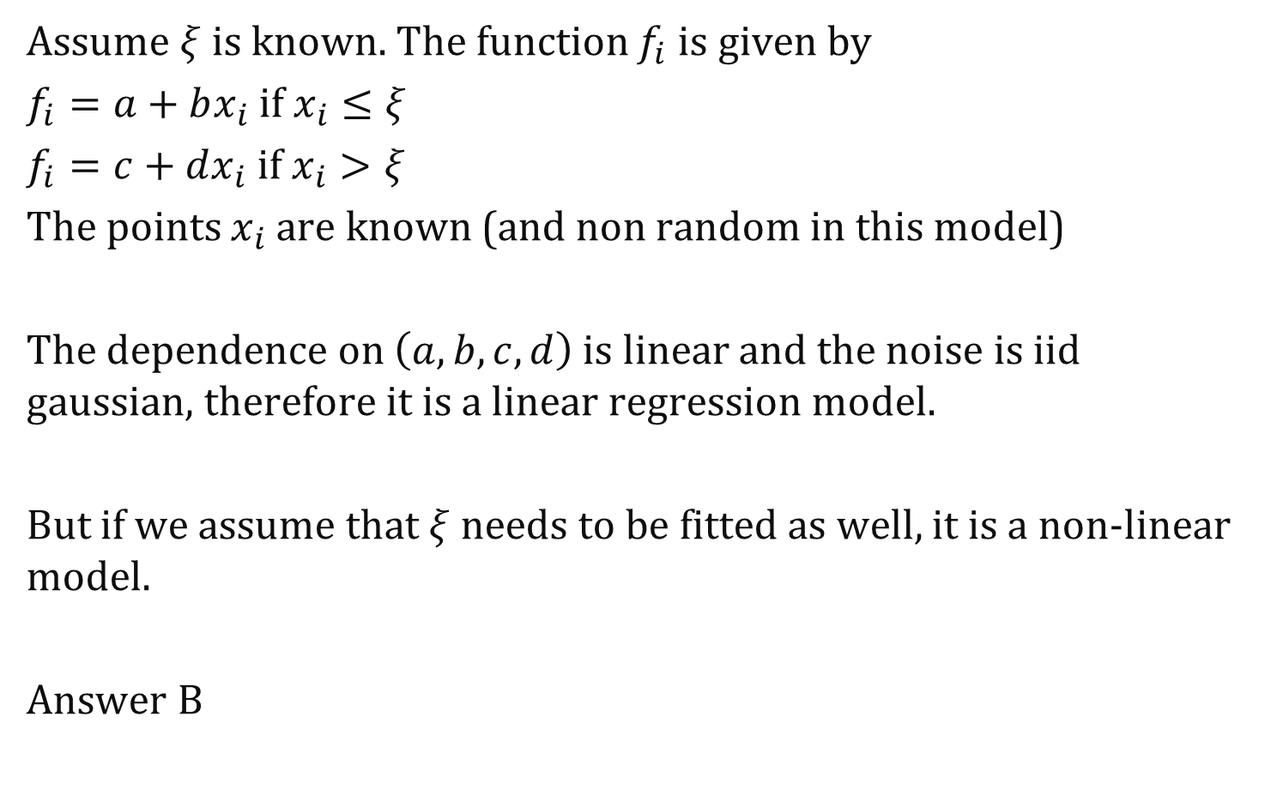
Assume $ξ$ is known. The function $f_{i}$is given by
$f_{i}=a+bx_{i}$ if $x_{i}≤ξ$
$f_{i}=c+dx_{i}$ if $x_{i}>ξ$
The points $x_{i}$ are known (and non random in this model)
The dependence on $\left(a,b,c,d\right)$ is linear and the noise is iid gaussian, therefore it is a linear regression model.
But if we assume that $ξ$ needs to be fitted as well, it is a non-linear model.
Answer B

Slide 34
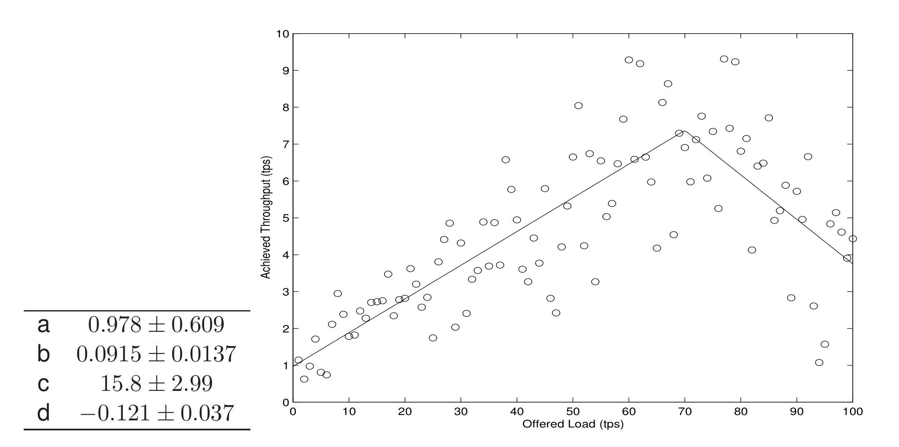

Solution assuming $ξ=70$

Slide 35
Validate the Assumptions with Residuals

Slide 36
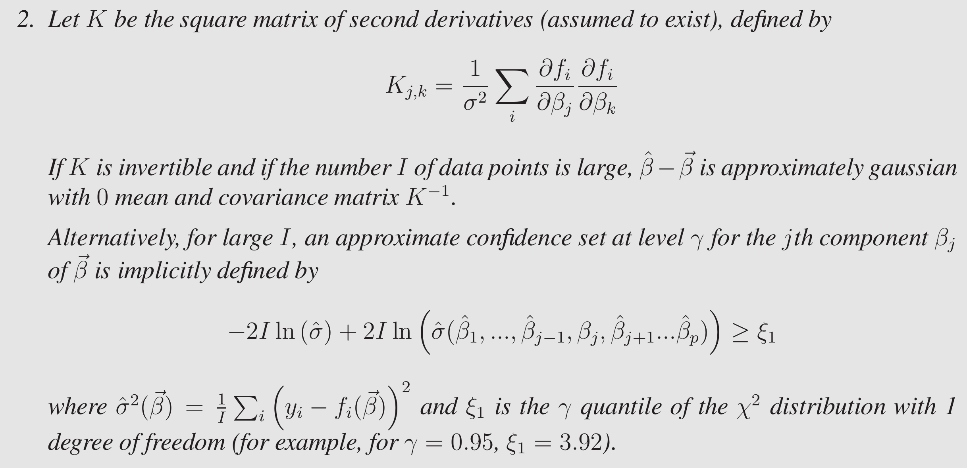
Non-linear case: use the likelihood function

Slide 37
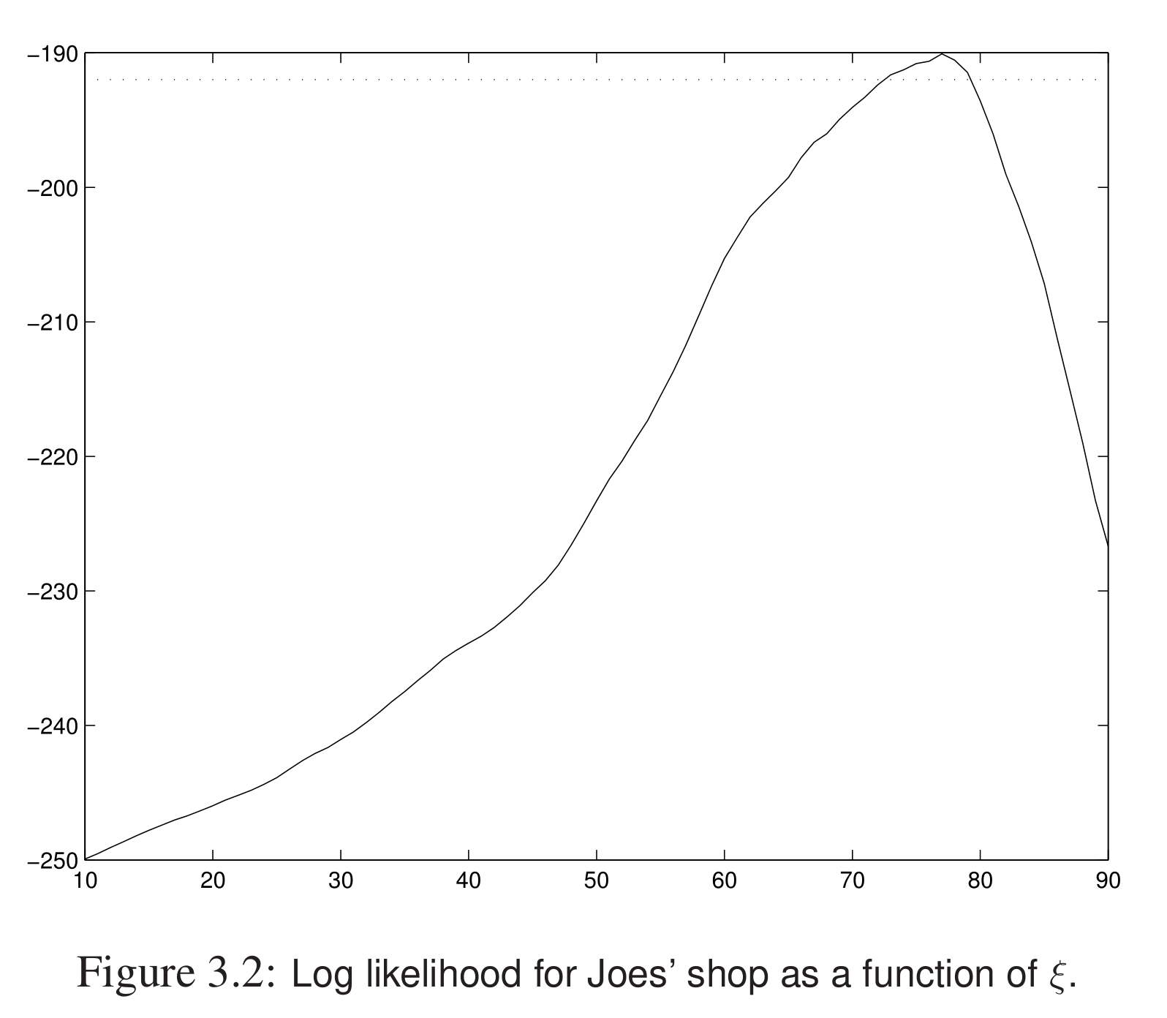

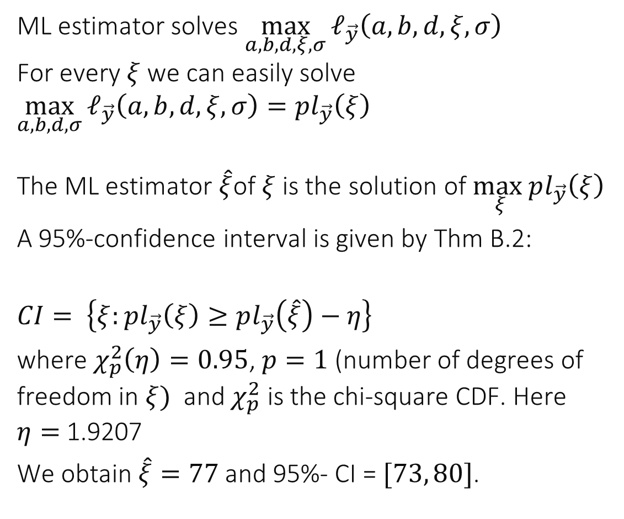

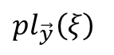

Estimation of Breakpoint $ξ$
ML estimator solves $\max_{a,b,d,ξ,σ}{ℓ_{\vec{y}}\left(a,b,d,ξ,σ\right)}$ For every $ξ$ we can easily solve $\max_{a,b,d,σ}{ℓ_{\vec{y}}\left(a,b,d,ξ,σ\right)}=pl_{\vec{y}}\left(ξ\right)$ The ML estimator $\hat{ξ}$of $ξ$ is the solution of $\max_{ξ}pl_{\vec{y}}\left(ξ\right)$
A 95%-confidence interval is given by Thm B.2:
$CI= \left\{ξ:pl_{\vec{y}}\left(ξ\right)≥pl_{\vec{y}}\left(\hat{ξ}\right)−η\right\}$
where $χ_{p}^{2}\left(η\right)=0.95$, $p=1$ (number of degrees of freedom in $ξ)$ and $χ_{p}^{2}$ is the chi-square CDF. Here $η=$ 1.9207
We obtain $\hat{ξ}=77$ and 95%- CI = $[73, 80]$.
$$Y_{i}=\left(a+bx_{i}\right)1_{x_{i}≤ξ}+\left(c+dx_{i}\right)1_{x_{i}>ξ}+ε_{i}, ε_{i}∼iid N(0,σ^{2})$$
with $a+bξ=c+dξ$
1.9207
$$pl_{\vec{y}}\left(ξ\right)$$
$$ξ$$
$$\hat{ξ}$$

Slide 38



Slide 39


3. $ℓ^{1}$- Norm Minimization Laplace Noise
Recall that the pdf of the $\exp{(λ)}$ distribution is $f\left(x\right)=λe^{−λx}1_{x≥0}$ and its CDF is $F\left(c\right)=1−e^{−λc}$
Consider the following sampling method:
Draw $Y∼\exp{(λ)}$
With probability 0.5, let $X=Y,$ with probability 0.5 let $X=−Y$
The output $X$ is called Laplace Noise
What is its pdf ?

Slide 40

The PDF of Laplace noise is …
$f \left(x\right) = \frac{λ}{2} e^{λx} +\frac{λ}{2} e^{−λx}$
$f\left(x\right)=\frac{λ}{2}e^{−λ|x|}$
$f\left(x\right)=\frac{λ}{2}e^{−λ|x|}+\frac{λ}{2}e^{−λx}$
$f\left(x\right)=\frac{λ}{2}e^{−λ|x|}+\frac{λ}{2}e^{λ|x|}$
I don’t know

Slide 41

Solution
Method 1 (heuristic) Let $Q=1$ when we choose the first alternative (i.e. we do $X=Y)$ and $Q=0$ otherwise.
Let $x>0:$ the event $X∈\left[x, x+dx\right]$ is equal to $\left(Q=1\right)and (Y∈\left[x, x+dx\right])$ . Its probability is $\frac{1}{2}×λe^{−λx}dx+o(dx)$. Thus $f_{X}\left(x\right)=\frac{1}{2}×λe^{−λx}$ when $x>0$
Let $x<0:$ the event $X∈\left[x, x+dx\right]$ is equal to $\left(Q=0\right)and (Y∈\left[−x−dx, −x\right])$ . Its probability is $\frac{1}{2}×λe^{−λ|x|}dx+o(dx)$. Thus $f_{X}\left(x\right)=\frac{1}{2}×λe^{−λ|x|}$ when $x<0$
Answer B

Slide 42

Method 2 (rigorous)
For an arbitrary test function $φ$, let us compute $E\left(φ\left(X\right)\right)$
If we can write it under the form$E\left(φ\left(X\right)\right)=\int_{−∞}^{+∞}{φ\left(x\right)f_{X}\left(x\right)dx}$ this will uniquely define $f_{X}(x)$
$$E\left(φ\left(X\right) | Q=1\right)=E\left(φ\left(Y\right)\right)=\int_{0}^{+∞}{φ\left(x\right)λe^{−λx}dx}=\int_{0}^{+∞}{φ\left(x\right)λe^{−λ|x|}dx} \\ E\left(φ\left(X\right) | Q=0\right)=E(φ\left(−Y\right)))=\int_{0}^{+∞}{φ\left(−x\right)λe^{−λx}dx}=\int_{−∞}^{0}{φ\left(x\right)λe^{λx}dx}=\int_{−∞}^{0}{φ\left(x\right)λe^{−λ|x|}dx}$$

Slide 43





Laplace Noise
The distribution with pdf $f_{X}\left(x\right)=\frac{1}{2}λe^{−λ| x|}$ is called the Laplace distribution, or 2-sided exponential distribution.
Its mean is 0 (by symmetry of the pdf) and its variance is $\frac{2}{λ^{2}}$
It can be used to model noise that has a heavier tail than gaussian noise; very large values are not too unlikely.
1-CDF
PDF
Normal(0,1)
$$P(X>x)$$
Laplace(1.414)
$$x$$

Slide 44


$ℓ^{1}$-Norm Minimization = Laplace Noise
Assume model (homoscedasticity)
i.e. the signal processing method with $ℓ^{1}$score is the same as the statistical method with iid Laplace noise.

Slide 45



LS and $ℓ^{1}$score functions
Given a model to be fitted $Y_{i}=f_{i}\left(θ\right)+noise$ we have the equivalences:
Score | Statistical model
Least Square: $score=\sum_{i}{{\left(noise_{i}\right)}^{2}}$ | $$noise∼iid N(0, σ^{2})$$
Weighted Least Square: $score=\sum_{i}{{\left(w_{i} × noise_{i}\right)}^{2}}$ | $${noise}_{i}∼iid N\left(0,\frac{σ^{2}}{w_{i}^{2}}\right)$$
$ℓ^{1}$ $score=\sum_{i}{|{noise}_{i}|}$ | $$noise∼iid Laplace(λ)$$
$ℓ^{1} score=\sum_{i}{w_{i}|{noise}_{i}|}$ | $${noise}_{i}∼iid Laplace(λw_{i})$$

Slide 46


LS versus $ℓ^{1}$- norm minimization
Virus propagation example: both fits give the same result in log-scale

Slide 47





$ℓ^{1}$- norm minimization is more robust to « Outliers »
LS
$ℓ^{1}$

Slide 48



To understand the difference between LS and $ℓ^{1}$ consider the simple example $y_{i}=m+noise$ i.e. fit a cloud of data to a single value
Least Square
L1 Norm Minimization
Model: $$y_{i} = m +ε_{i}, ε_{i} iid∼N\left(0,σ^{2}\right)$$
What is m ?
Confidence interval ?
Model: $$y_{i} = m +ε_{i}, ε_{i} iid∼Laplace(λ)$$
What is m ?
Confidence interval ?

Slide 49


What is the LS fit of $m$ in $y_{i}=m+noise ?$
$m=$ median of $y_{i}$
$m=\overline{y} where \overline{y}=sample mean of y_{i}$
$m=\overline{y}+\frac{{\hat{σ}}^{2}}{\overline{y}}$ where ${\hat{σ}}^{2}=\frac{1}{I}\sum_{i}^{I}{{\left(y_{i}−\overline{y} \right)}^{2}}$
$m=\overline{y}+\frac{{\hat{σ}}^{2}}{\overline{y}}$ where ${\hat{σ}}^{2}=\frac{1}{I−1}\sum_{i}^{I}{{\left(y_{i}−\overline{y} \right)}^{2}}$
I don’t know

Slide 50

Solution
For LS fit, $m$ minimizes $\sum_{i=1}^{I}{{\left(y_{i}−m\right)}^{2}}$; now
$$\sum_{i}^{I}{{\left(y_{i}−m\right)}^{2}}=\sum_{i}^{I}{{\left(y_{i}−\overline{y}\right)}^{2}}+I{\left(m−\overline{y}\right)}^{2}$$
Thus the minimum is for $m=\overline{y}$.
Answer B

Slide 51



Alternative solution: use Theorem 3.3:
$$Y_{i}=m+ε_{i}, for i=1…I; \vec{β}=m$$
$$\left(\begin{aligned}y_{1} \\ … \\ y_{I}\end{aligned}\right)=\left(\begin{aligned}1 \\ … \\ 1\end{aligned}\right)m+ε$$
$$X^{T}X=\left(1…1\right)\left(\begin{aligned}1 \\ … \\ 1\end{aligned}\right)=I$$
$$K=\frac{1}{I}\left(1…1\right)$$
$$\hat{m}=K\left(\begin{aligned}y_{1} \\ … \\ y_{I}\end{aligned}\right)=\frac{1}{I}\sum_{i}^{I}{y_{i}}=\overline{y}$$
$$X$$

Slide 52


What is the ${ℓ }^{1}$ fit of $m$ in $y_{i}=m+noise ?$
$m=\overline{y} where \overline{y}= mean of y_{i}$
$m=$ median of $y_{i}$
$m=\overline{y}+\frac{{\hat{σ}}^{2}}{\overline{y}}$ where ${\hat{σ}}^{2}=\frac{1}{I}\sum_{i=1}^{I}{{\left(y_{i}−\overline{y} \right)}^{2}}$
$m=\overline{y}+\frac{{\hat{σ}}^{2}}{\overline{y}}$ where ${\hat{σ}}^{2}=\frac{1}{I−1}\sum_{i=1}^{I}{{\left(y_{i}−\overline{y} \right)}^{2}}$
I don’t know

Slide 53









For $ℓ^{1}$ fit, $m$ minimizes $\sum_{i=1}^{I}{|y_{i}−m|}$; Consider the mapping $m↦f\left(m\right)=\sum_{i=1}^{I}{|y_{i}−m|}$ e.g. when $y_{(1)}<m<y_{(2)}$ $f\left(m\right)=\left(m−y_{\left(1\right)}\right)+$ $\left(y_{\left(2\right)}−m\right)+\left(y_{\left(3\right)}−m\right)+$ $(y_{\left(4\right)}−m)$ $+(y_{\left(5\right)}−m)$ and $f^{′}\left(m\right)=1−4=−3$
In general when $m$ is not one of the $y_{i}$ $f^{′}\left(m\right)=nb points below m−nb points above m$ ; when $I$is odd:
$f$ decreases for $m<median$ and $f$ increases for $m>median$
Answer B
$$f(m)$$
$$m$$
$$y_{(1)}$$
$$y_{(2)}$$
$$y_{(3)}$$
$$y_{(4)}$$
$$y_{(5)}$$

Slide 54



LS vs $ℓ^{1}$ : intuitive comparison
$ℓ^{1}$ is more robust than LS, less sensitive to outliers
Confidence intervals are simple with LS – but meaningful only if normal assumption holds

Slide 55



Linear Regression with $ℓ^{1}$ norm minimization
= $ℓ^{1}$ norm minimization + linear dependency on parameter
More robust than LS linear regression
Less traditional

Slide 56

This is linear programming

Slide 57


Slide 58


Confidence Intervals
No closed form
We can use an approximate solution based on simulation (“Bootstrap”)
a | $\text{1.4}\text{9}±\text{0.60}$1
b | $$\text{0.079}±\text{0.}\text{0143}$$
c | $$\text{1}\text{1}\text{.}\text{2}±\text{2}\text{.}\text{96}$$
d | $−0.06\text{2}±\text{0.}\text{0368}$

Slide 59

4. Bootstrap : Computation of Confidence Interval
We have a parametric model with parameters $β,λ$ and want to find a confidence interval $\left[U, V\right]$ for, say,$β_{1}$ ; let ${\hat{β}}_{1}$ be our estimator of $β_{1}$
Recall that $U,V$ is a function of the data (hence is random); we want to have $P_{β, λ}\left(U≤β_{1}≤V\right)≥0.95$for any $β,λ$
Assume someone tells us the true value of $β,λ$; in theory, we can compute the quantiles of the distribution of ${\hat{β}}_{1}$; let
$U_{β, λ}=2.5\%$ quantile of ${\hat{β}}_{1}$ and ${ V}_{β, λ}=97.5\%$ quantile of ${\hat{β}}_{1}$ We have $$P_{β, λ}\left(U_{β, λ}≤{\hat{β}}_{1}≤V_{β, λ}\right)=0.95$$
We have computed an estimator $\hat{β},\hat{λ}$; we take as approximate confidence interval $U=U_{\hat{β},\hat{λ}}$ and $V=V_{\hat{β},\hat{λ}}$

Slide 60

Parametric Bootstrap Computation of CI (cont’d)
Let $U_{β, λ}=2.5\%$ quantile of ${\hat{β}}_{1}$ and ${ V}_{β, λ}=97.5\%$ quantile of ${\hat{β}}_{1}$
We take as approximate confidence interval $U=U_{\hat{β},\hat{λ}}$ and $V=V_{\hat{β},\hat{λ}}$
How can we practically compute $U_{β, λ}$, $V_{β, λ}$ when we know $β,λ$? By Monte-Carlo simulation:
Assume you know $β, λ$
Do $r=1:R$ simulate $Y_{i} , i=1…I$ from the model obtain an estimate ${\hat{β}}_{1}^{r}$ end
$$U_{β, λ}=2.5\% quantile of {\hat{β}}_{i}^{r}, V_{β, λ}=97.5\% quantile of {\hat{β}}_{i}^{r}$$ e.g. with $R=999, U_{β, λ}={\hat{β}}_{1}^{(25)}$ and $V_{β, λ}={\hat{β}}_{1}^{(975)}$
Do the above with $\left(β, λ\right)=(\hat{β},\hat{λ}$) – this is called Parametric Bootstrap

Slide 61


Example
We have obtained $\hat{λ}=1.0055$
For $r=1:999$ we draw $I$ residuals $∼Laplace\left(1.0055\right)$ and simulate $I$ artificial data points $y_{i}^{r}, i=1…I$ from the fitted model
For each replay experiment we estimate $a,b,c,d$ and obtain $R=999$ estimates ${\hat{a}}^{r},{\hat{b}}^{r},{\hat{c}}^{r},{\hat{d}}^{r}$
A confidence interval for $d$ is $\left[{\hat{d}}^{(25)},{\hat{d}}^{(975)}\right]$
a | $\text{1.4}\text{9}±\text{0.60}$1
b | $$\text{0}\text{.}\text{079}±\text{0}\text{.}\text{0143}$$
c | $$\text{1}\text{1}\text{.}\text{2}±\text{2}\text{.}\text{96}$$
d | $−0.06\text{2}±\text{0.}\text{0368}$

Slide 62

Bootstrap with Resample From Residuals
Instead of simulating the noise from the model -- by drawing from Laplace($λ$) -- assume we draw $I$ noise samples from the residuals with replacement.
This method is called Bootstrap with Resampling from Residuals

Slide 63


Slide 64




$$ξ=69$$
CI with Parametric Bootstrap, 999 replays
CI with Bootstrap, Resampling from Residuals, 999 replays
a | $\text{1.4}\text{9}±\text{0.60}$1
b | $$\text{0.079}±\text{0.}\text{0143}$$
c | $$\text{1}\text{1}\text{.}\text{2}±\text{2}\text{.}\text{96}$$
d | $−0.06\text{2}±\text{0.}\text{0368}$

Slide 65

Other Uses of the Bootstrap
The idea of the bootstrap is to use the data itself as estimate of the unknown distribution of the data
Can be used to obtain confidence or predictions intervals in a very simple way --- tends to underestimate
Example: CI for the mean of a data set $y_{i}$ the model is $Y_{i}∼iid F()$ and the problem is to estimate the mean of $F\left(\right)$ with the bootstrap we replace the unknown $F()$ by the empirical distribution of the data itself, i.e. the distribution that puts probability $\frac{1}{I}$ at every $y_{i} , i=1…I$

Slide 66



Which algorithm is a correct implementation of the bootstrap for a 95% CI of the mean of $y_{1},…,y_{I}$ ?
A
B
Both
None
I don’t know
Algorithm A
for $r=1:999$
for $n=1:I$ draw one integer $K∼unif \{1,…,I\}$
$x_{n,r}=y_{K}$
end
end for $r=1:999$
$m_{r}=mean(x_{1,r},…,x_{I,r})$
end
CI =$[m_{\left(25\right)}, m_{(975)}]$
Algorithm B
for $r=1:999$
draw a random permutation $σ$ of $\{1,…,I\}$
$x_{n,r}=y_{σ(n)}, n=1…I$
end
end for $r=1:999$
$m_{r}=mean(x_{1,r},…,x_{I,r})$
end
CI =$[m_{\left(25\right)}, m_{(975)}]$

Slide 67

Solution
Answer A
The boostrap replaces the model $Y_{i}∼iid F()$ by $Y_{i}∼iid\hat{ F}()$ where $\hat{F}()$ is the empirical distribution of the $I$data points $y_{i}$.
One replay experiment simulates the data from the model $Y_{i}∼\hat{F}()$, i.e. draws $I$independent samples from $\hat{F}\left(\right)$
Q: How does one draw one sample $Y$ from $\hat{F}\left(\right)$ ? A: Draw an index $K∈\left\{1,…,I\right\}$ uniformly at random and let ${Y=y}_{K}$
Algorithm A does this, algorithm B does not (not iid). Note that we need to resample with replacement.

Slide 68



Example: Compiler Options, CI for mean
Assuming data is normal (Thm 2.3)
Bootstrap
Assuming $n$ is large and variance is finite (Thm 2.2)

Slide 69

Conclusion
The statistical method for fitting a model requires modeling the noise.
Verifying the residuals increases the confidence in the model.
Least square fit corresponds to gaussian noise, $ℓ^{1}$ fit corresponds to Laplace noise (heavier tail).
Least square methods are very efficient but are less robust than $ℓ^{1}$ methods.
The boostrap is a proxy for computing approximate confidence intervals.

